Slide 1
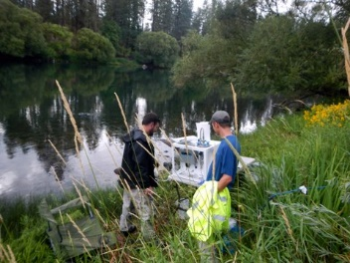
SRRTTF Synoptic Sampling Event August 2015

Slide 2
Planning
Sample scoping meeting and site reconnaissance on July 28 - 29, 2014
Scope revised to include vessel use, high volume sampling, and in-field stream flow
Lab coordination with AXYS for high volume extraction
Revisions to SAP with LimnoTech
Health and safety plan and invasive species plan
Field implementation plan prepared

Slide 3
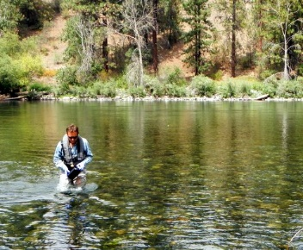
Water Sampling
Commenced on August 12, 2014
8 river gage stations sampled on August 12, 14, 16, 18, 20, 22, and 24
7 facility stations sampled on August 13, 19, and 21
High volume sampling at 2 river gage stations on August 15 and 24
Normal, composite, and archive samples were collected
Daily QA/QC samples included blanks and replicate (duplicate)

Slide 4
Sampling Methodology
All samples collected using “clean hands” and “dirty hands” consistent with EPA Document 1669
Direct immersion sampling at most locations
Dip sampler used at a few facilities due to safety concerns (e.g., confined space)
High volume water sampling
In-field measurements for temperature, pH, specific conductivity, turbidity, and dissolved oxygen

Slide 5
Sample Handling, Transport, and Custody
All samples were kept on ice (from field lab freezers), secured in locked vehicle
Samples were hand delivered each morning to SVL and shipped via FedEx to AXYS
Custody records and seals were used

Slide 6
Deviations from SAP and Corrective Action
Hayden facility not sampled – zero low flow discharge to Spokane River
SR-4 not collected on August 12 due to wind and lightning – collected the following day
FedEx system-wide computer shutdown held up samples shipped on August 18th for an extra day – samples arrived slightly over recommended temperature
Stream flow at SR9 not measured August 22 due to equipment malfunction
Two sample jars broke during shipment to AXYS; 1 was a duplicate and other was from SR9 – archive sample later sent for analysis
Additional sample collected at SR15 on August 23 due to rainfall event

Slide 7
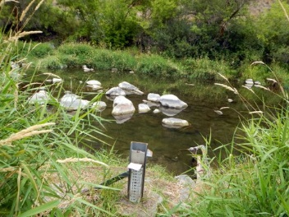
Stream Flow
No Stream Gauge data were available at SR-9 (Green Acres) – in-stream measurements were collected
Green Street Gauge data were not available - station was unexpectedly shut down
Coeur d'Alene data included only height information not flow

Slide 8
Reporting
Draft Field Sampling Report was submitted in October 2014 and summarized the following:
Methods for sampling, handling, and analyses
Identified samples collected including QA/QC
Field parameters measured
Available gage station flow data
Identified deviations
Final Field Sampling Report will be submitted in January 2015 (following input at this meeting)

Slide 9
Data Observations
Progressively higher concentrations as you move from Lake to Nine Mile
Some sampling locations had very high standard deviation (e.g. Hangmans)
No obvious trending of congeners to lower chlorinated states
Top PCBs in river = 11, 61, 52, 20
Top PCBs in facilities = 20, 118, 52, 61
SR-12 composite was 3X higher than discrete grabs
High Blank Contamination from Atmospheric conditions observed

Slide 10
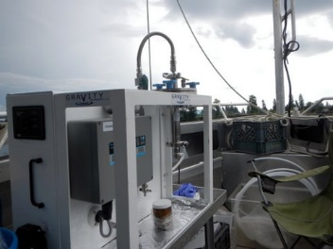
High Volume Sampling and Analysis
125-145 congeners detected with HVS and 60-85 through traditional sampling
Dissolved phase was found at concentrations approximately 4 times solid phase
PCB concentrations in HVS were approximately 2 times higher at 9-mile versus the upstream lake output
Correlations with other parameters (e.g., TSS) have not been evaluated
Congener fingerprinting has not been investigated

Slide 11
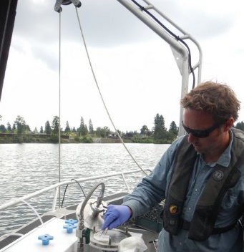
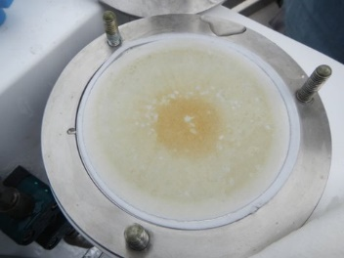
More HVS

Slide 12
Lessons Learned in the Field
Communication with the facilities is key to daily sampling schedule
Additional forethought on available flow data and potential need (and tools) to gather in-field flow data
High volume sampling provided more sensitive PCB measurements
Because of protective foam for shipping jars, blue ice was less effective in cooling than double-bagged ice
Additional field parameter instrument calibrations and backup solutions may be useful

Slide 13
Recommendations for future studies
Collect data over multiple seasons to understand SD
Install current profiler (ADCP) at Coeur d'Alene station
Additional HVS sampling stations on river and at facilities
Investigate hyporeic zones – input to dissolved phase pcb sources in focus areas
Collect fine sediments from potential source areas – vortex sampling

Slide 14
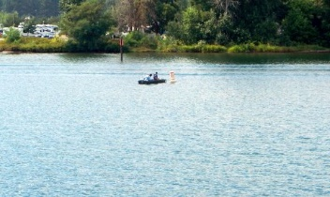
Questions

