Slide 1
Mass Balance Assessment of 2014 Synoptic Survey Results:
Dave Dilks
Spokane River Regional Toxics Task Force
2014 Workshop
January 13, 2015

Slide 2
Outline
Synoptic survey
Mass balance assessment
  Approach and findings
Uncertainty analysis
  Approach and findings
Conclusions
Notes:
.

Slide 3
Synoptic Survey
August 12-24, 2014
Seven Spokane River stations, plus Hangman Creek
  Each sampled seven times
Seven point source discharges
  Sampled three times

Slide 4
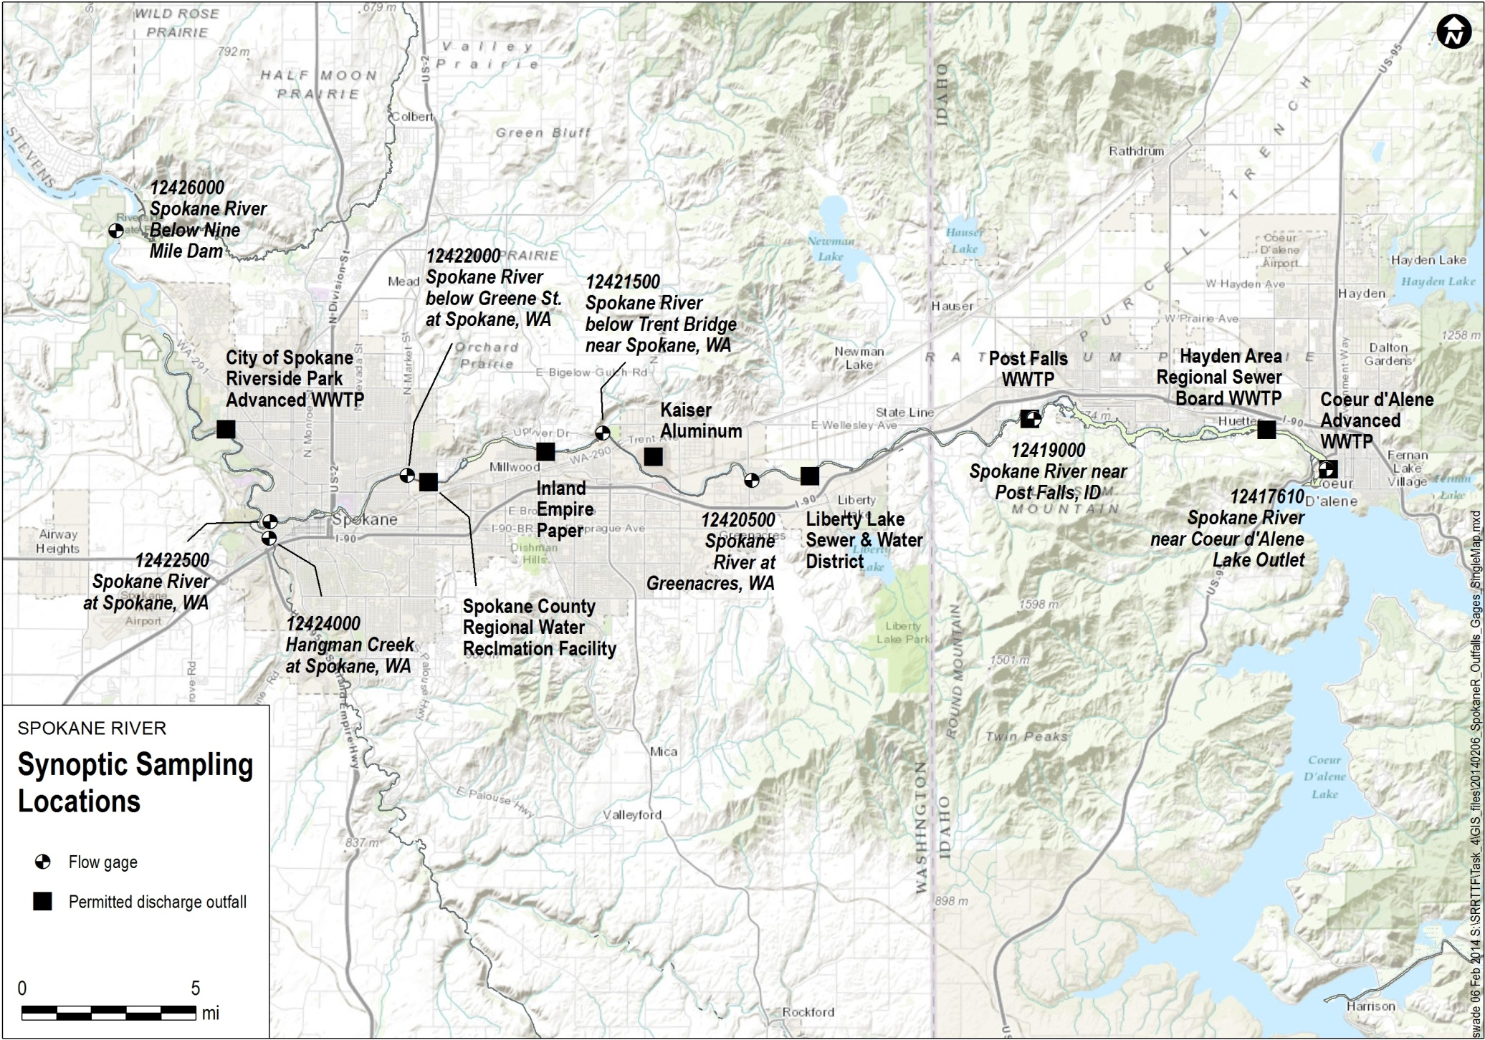

(Barker Rd.)

Slide 5
Intent of Synoptic Survey
Support dry weather mass balance assessment
  Measure river concentration at flow gaging locations
  Measure all known dry weather sources
Identify unknown sources between each station
  Unknown source = Downstream load – Upstream load – Known Load
Notes:
Consistent with SRRTTF objective of “Characterize the sources of toxics in the Spokane River”

Slide 6
Mass Balance Approach
Measure flow (Q) and total PCB concentration (C) at paired upstream and downstream stations
  Q_{d}, C_{d} River Reach Q_{u}, C_{u}

Slide 7
Mass Balance Approach
Calculate unmonitored load between stations
  Unmonitored load = Downstream load – upstream load
  Q_{d}, C_{d} River Reach Q_{u}, C_{u}
Unmonitored
Load

Slide 8
Mass Balance Approach
But what about instream reaction processes?
  Adsorption/settling, resuspension, volatilization
Results from CE-QUAL-W2 model combined with typical PCB kinetic coefficients
  Each loss component determined to be small
  Q_{d}, C_{d} River Reach Q_{u}, C_{u}
Unmonitored
Load
Notes:
Solids concentration low and largely inorganic; residence time too short

Slide 9
Mass Balance Equations
Load (W) = Concentration times flow
  Downstream load = Q_{d}*C_{d}
  Upstream load = Q_{u}*C_{u}
  Unmonitored load (W?) = Q_{d}*C_{d} - Q_{u}*C_{u}
  W?
  Q_{d}, C_{d} River Reach Q_{u}, C_{u}

Slide 10
Unmonitored Load Components
Calculate unmonitored flow and concentration
  Q? = Q_{d} – Q_{u}
  Q_{u}*C_{u} + Q?*C? = Q_{d}*C_{d}
C? = [Q_{d}C – Q_{u}*C_{u}]/Q?
  Q?, C?
  Q_{d}, C_{d} River Reach Q_{u}, C_{u}

Slide 11
Expand to Consider Point Sources
Equation can be expanded to consider point sources (and tributaries)
  Unmonitored load = Downstream load – upstream load – point source load
  Q_{p},C_{p} Q?,C?
  Q_{d}, C_{d} River Reach Q_{u}, C_{u}

Slide 12
Equations with Point Sources
Calculate unmonitored flow and concentration
  Q? = Q_{d} – Q_{u}– Q_{p}
  Q_{u}*C_{u} + Q?*C? + Q_{p}*C_{p} = Q_{d}*C_{d}
C? = [Q_{d}C_{d} – Q_{u}*C_{u}– Q_{p}*C_{p}]/Q?
  Q_{p},C_{p} Q?,C?
  Q_{d}, C_{d} River Reach Q_{u}, C_{u}

Slide 13
Groundwater Interactions
Spokane River flows into and out of its adjacent groundwater aquifer
This requires some adjustments to the mass balance calculations

Slide 14
Losing Reaches
Can estimate incremental loads in losing reaches
  Q_{u}*C_{u} + W? - Q_{l}*C_{l} = Q_{d}*C_{d}
W? = [Q_{d}*C_{d} – Q_{u}*C_{u}+ Q_{l}*C_{l}]
  Q_{l},C_{l} W?
  Q_{d}, C_{d} River Reach Q_{u}, C_{u}

Slide 15
Re-Gaining Reaches
Can separate out unknown load from return of load from upstream losing reaches
  Q_{u}*C_{u} + W? + Q_{l}*C_{l} = Q_{d}*C_{d}
W? = [Q_{d}C_{d} – Q_{u}*C_{u}- Q_{l}*C_{l}]
  W? Q_{l},C_{l}
  Q_{d}, C_{d} River Reach Q_{u}, C_{u}
Notes:
If we don’t separate these terms, returning river flow implies that a large external source is present

Slide 16
Mass Balance Application
Compile data
Define concentrations expected from known loads
Assess presence unknown loads

Slide 17
Mass Balance Data Sources
River flows
  USGS gages
  Gravity
Discharge flows
  Provided by dischargers
PCB concentrations
  Synoptic survey

Slide 18
River Flows
Flow (cfs)
 | 8/12 | 8/14 | 8/16 | 8/18 | 8/20 | 8/22 | 8/24
Post Falls | 637 | 648 | 632 | 809 | 916 | 815 | 733
Barker Rd. | - | 271 | 347 | 484 | 572 | - | 323
Trent Ave. | 927 | 923 | 919 | 989 | 1060 | 1050 | 948
Spokane | 1030 | 1050 | 1080 | 1140 | 1250 | 1140 | 1140
Hangman Ck. | 10 | 11 | 15 | 17 | 19 | 18 | 18
Nine Mile | 1040 | 1040 | 1060 | 1190 | 1250 | 1080 | 1120

Slide 19
Discharge Flows
Discharge (cfs)
 | 8/13 | 8/19 | 8/24
Coeur d’Alene | 5.3 | 5.4 | 5.4
HARSB | 0 | 0 | 0
Post Falls | 3.8 | 3.9 | 4.0
Liberty Lake | 1.1 | 1.1 | 1.2
Kaiser Aluminum | 13.3 | 14.4 | 13. 8
Inland Empire Paper | 11.3 | 10.9 | 11.0
Spokane County | 11.8 | 11.6 | 11.6
City of Spokane | 43.6 | 45.7 | 43.0

Slide 20
Discharge PCB Concentrations
Total PCB (pg/L)
 | 8/13 | 8/19 | 8/21 | Composite
City of Spokane | 771/955 | 23404 | 1177 | 878
Spokane County | 490 | 330/290 | 333 | 274
Inland Empire Paper | 3627 | 2957 | 2636/2629 | 2766
Kaiser Aluminum | 3276 | 4012 | 4625 | 2514
Liberty Lake | 200 | 193 | 260 | 211
Post Falls | 221 | 219 | 200 | 176
Coeur d’Alene | 1227 | 534 | 531 | 668

Slide 21
River PCB Concentrations
Total PCB (pg/L)
 | 8/12 | 8/14 | 8/16 | 8/18 | 8/20 | 8/22 | 8/24 | Composite
Nine Mile | 156/197 | 193 | 179 | 172 | 228 | 97 | 84 | 136
Hangman Ck. | 64 | 66 | 67/73 | 53 | 2444 | 265 | 35 | 95
Spokane Gage | 163 | 163/144 | 303 | 203 | 158 | 399 | 86 | 137
Greene St. | 164* | 207 | 110 | 124/106 | 181 | 74 | 59 | 124
Trent Ave. | 168 | 117 | 152 | 399 | 158/172 | 95 | 120 | 111
Barker Rd. | 28 | 17 | 9 | 47 | 11 | 1/28 | 10 | 29
Post Falls | 53 | 9 | 22 | 19 | 17 | 19 | 17/9 | 227
Coeur d’Alene | 19 | 31 | 11 | 9 | 7 | 7 | 5** | 11
* Collected 8/13
** Collected 8/23

Slide 22
River Concentrations
← Flow

Slide 23
Assessment Using only Known Loads
Compute segment by segment concentrations
  Use average point source flows and concentrations measured during the synoptic survey

Slide 24
Predicted Concentrations Using only Known Loads
← Flow

Slide 25
Best Estimate of Unknown Loads
River Reach | Groundwater Interaction | Unknown Load (mg/day)
 |  | All Data | Outliers Excluded
Coeur d’Alene to Post Falls | Losing | 10 | -
Post Falls to Barker Road | Losing | - | 1.3
Barker Road to Trent Avenue | Mixed (losing, then gaining) | 241 | 166
Trent Avenue to Spokane Gage | Mixed (gaining, then (losing) | 52 | -
Spokane Gage to Nine Mile | Mixed (losing, then gaining) | - | -

Slide 26
Best Estimate of Unknown Loads

Slide 27
Consideration of Uncertainty
Need to recognize uncertainty/variability in flows and concentrations
  Uncertainty: Concentrations close to blanks
  Variability: Concentrations and flows vary from day-to-day
Re-state model inputs as probability distributions rather than single values
  W_{i} = Q_{d}*C_{d} - Q_{u}*C_{u}

Slide 28
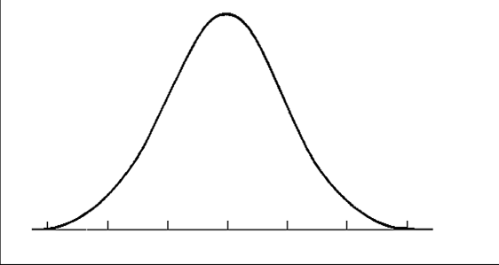
Probability Distributions
Describe expected probability of occurrence of entire range of values
Probability
0 0.1 0.2 0.3 0.4
0 2 4 6 8 10
Concentration

Slide 29
Probability Distributions
Higher uncertainty corresponds to broader curves
Low Moderate High
Probability
0 0.1 0.2 0.3 0.4 0.6
Probability
0 0.1 0.2 0.3 0.4
Probability
0 0.1 0.2 0.3
0 2 4 6 8 10
Concentration
0 2 4 6 8 10
Concentration
0 2 4 6 8 10 12 14 16 18 20 22
Concentration

Slide 30
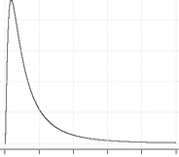
Defining Probability Distributions
Need three pieces of information
  Central tendency (mean)
  Variance (spread)
  Shape of distribution
        Normal Log-Normal
    Shape determined by goodness-of-fit testing

Slide 31
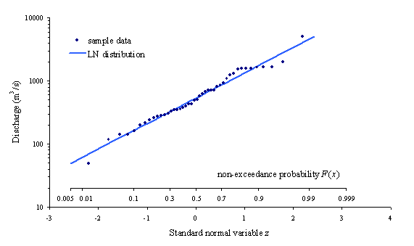
Goodness-of-Fit Testing
Compare observed distribution of data to idealized distribution
  Rank values
  Plot on probability paper
  Examine fit
Process now applied via statistical packages

Slide 32
Defining Uncertainty in Model Inputs
Flows
  Day to day variability
PCB Concentrations
  Day to day variability
  Uncertainty in measurement due to blank contamination

Slide 33
Defining Flow Uncertainty
Characterize day to day variability at each station
  Conduct goodness of fit testing to define type of distribution
  Calculate mean and standard deviation

Slide 34
Uncertainty in Concentration Inputs
Uncertainty in concentration inputs has two components
  Day to day variability at each station
  Uncertainty due to blank contamination
    Laboratory and field
Each component is evaluated separately, then combined

Slide 35
Daily Variability in Concentration
Characterize day to day variability at each station using the blank-correction method defined in the QAPP
QAPP Concentration (pg/l)
40 50 60 70 80 90

Slide 36
Uncertainty Due to Contamination
Characterize uncertainty by using an alternate blank correction method (no exclusion, subtract maximum of field and lab blank)
  Expressed as difference from the QAPP method
Δ Concentration (pg/L)
-30 -20 -10 0 10 20 30

Slide 37
Combining Sources of Uncertainty
Select value representing daily variability
Select value representing incremental uncertainty due to contamination
Combine to generate total uncertainty
60 70 80 90 -30 -20 -10 0 10 20 30 40 50 60 80 90 100 110
Daily Variability
Contamination Uncertainty
=
Total Uncertainty
+

Slide 38
Defining Uncertainty in Results
Characterize uncertainty in each model input
  Using best-fit statistical distribution
Use Monte Carlo analysis to characterize uncertainty in mass balance assessment

Slide 39
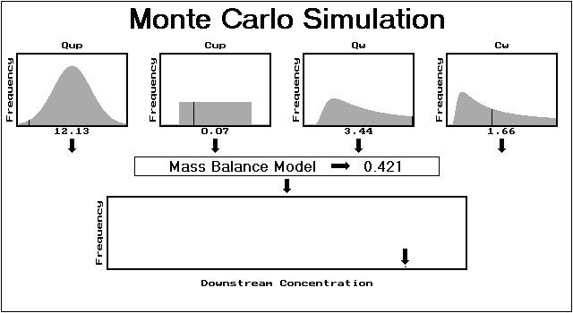
Defining Uncertainty in Results
Q_{u} C_{u} Q_{d} C_{d}
Characterize uncertainty in each model input as a statistical frequency distribution
Incremental Load

Slide 40
Defining Uncertainty in Results
Q_{u} C_{u} Q_{d} C_{d}
⁰ Incremental Load (mg/day) ^{0.5}
Randomly select inputs and run model

Slide 41
Defining Uncertainty in Results
Q_{u} C_{u} Q_{d} C_{d}
⁰ Unmonitored Load (mg/day) ^{0.5}
Tabulate results

Slide 42
Defining Uncertainty in Results
Q_{u} C_{u} Q_{d} C_{d}
⁰ Unmonitored Load (mg/day) ^{0.5}
Repeat process

Slide 43
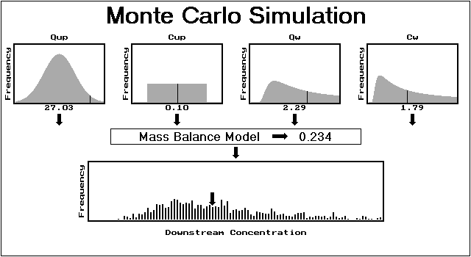
Defining Uncertainty in Results
Q_{u} C_{u} Q_{d} C_{d}
Q_{u} C_{u} Q_{d} C_{d}
⁰ Unmonitored Load (mg/day) ^{0.5}
Repeat process

Slide 44
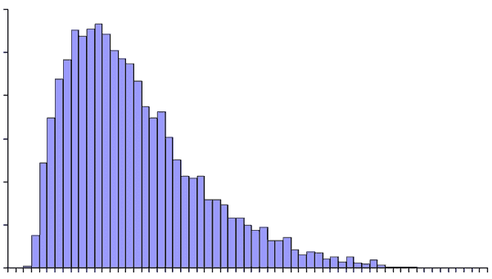
Defining Uncertainty in Results
Q_{u} C_{u} Q_{d} C_{d}
Output distribution completely characterizes uncertainty
  As long as inputs are characterized properly
⁰ Incremental Load (mg/day) ^{0.5}

Slide 45
Uncertainty Analysis Inputs:
River Flows
Flow (cfs)
 | Mean | Std. Dev. | Distribution | Serial Correlation
Lake Coeur d’Alene* | 735.6 | 109.8 | Normal | 0.92
Post Falls | 741.3 | 109.8 | Normal | 1.0
Barker Rd. | 399 | 124.4 | Normal | 0.92
Trent Ave. | 973.7 | 60.4 | Normal | 0.94
Spokane | 1118.6 | 73.8 | Normal | 0.84
Hangman Ck. | 14.4 | 3.8 | Normal | 0.92
Nine Mile | 1101.3 | 80.3 | Normal | 0.91
*Temporarily set at Post Falls flow minus average Coeur d’Alene WWTP flow

Slide 46
Uncertainty Analysis Inputs:
River Concentrations
Total PCB (pg/L)
 | Variability |  |  | Measurement Uncertainty
 | Mean | Std. Dev. | Distribution | Mean | Std. Dev. | Distribution
Lake Coeur d’Alene | 12.59 | 9.14 | Normal | 0 | 15.4 | Normal
Post Falls | 16.04 | 5.04 | Normal | 0 | 15.4 | Normal
Barker Rd. | 18.73 | 14.7 | Normal | 0 | 15.4 | Normal
Trent Ave. | 140 | 29.4 | Normal | 0 | 15.4 | Normal
Spokane | 152.8 | 38.1 | Normal | 0 | 15.4 | Normal
Hangman Ck. | 59.76 | 13.7 | Normal | 0 | 15.4 | Normal
Nine Mile | 163.2 | 49.6 | Normal | 0 | 15.4 | Normal

Slide 47
Uncertainty Analysis Inputs:
Discharge Flows
Flow (cfs)
 | Mean | Std. Dev. | Distribution
Coeur d’Alene | 5.35 | 0.03 | Normal
HARSB | 0 | 0 | Normal
Post Falls | 3.89 | 0.12 | Normal
Liberty Lake | 1.12 | 0.04 | Normal
Kaiser Aluminum | 13.8 | 0.56 | Normal
Inland Empire Paper | 11.1 | 0.22 | Normal
Spokane County | 11.7 | 0.10 | Normal
City of Spokane | 44.1 | 1.44 | Normal

Slide 48
Uncertainty Analysis Inputs:
Discharge Concentrations
Total PCB (pg/L)
 | Variability |  |  | Measurement Uncertainty
 | Mean | Std. Dev. | Distribution | Mean | Std. Dev. | Distribution
Coeur d’Alene | 533 | 3 | Lognormal | 0 | 15.4 | Normal
Post Falls | 214 | 12 | Lognormal | 0 | 15.4 | Normal
Liberty Lake | 218 | 36 | Lognormal | 0 | 15.4 | Normal
Kaiser Aluminum | 3949 | 673 | Lognormal | 0 | 15.4 | Normal
Inland Empire Paper | 2978 | 456 | Lognormal | 0 | 15.4 | Normal
Spokane County | 361 | 82 | Lognormal | 0 | 15.4 | Normal
City of Spokane | 972 | 209 | Lognormal | 0 | 15.4 | Normal

Slide 49
Results: Incremental Load by Reach
Lake Coeur d‘Alene to Post Falls
Post Falls to Barker Rd.

Slide 50
Incremental Load by Reach
Barker Rd. to Trent Ave.
Trent Ave. to Spokane Gage

Slide 51
Incremental Load by Reach
Spokane Gage to Nine Mile

Slide 52
Estimated Range of Unknown Loads
River Reach | Groundwater Interaction | Magnitude of Unknown Load (mg/day)
Coeur d’Alene to Post Falls | Losing | 0 to 14
Post Falls to Barker Road | Losing | 0 to 21
Barker Road to Trent Avenue | Mixed (losing, then gaining) | 94 to 157
Trent Avenue to Spokane Gage | Mixed (gaining, then (losing) | 0 to 80
Spokane Gage to Nine Mile | Mixed (losing, then gaining) | 0 to 81

Slide 53
Estimated Range of Unknown Loads

Slide 54
Loading Sources in Context
|------ Unknown/Groundwater ------|------ Other* ------|
*Stormwater loading estimate from Ecology (2011) Source Assessment

Slide 55
Conclusions
Synoptic survey identified a potential unknown source (between Barker Rd. and Trent Avenue)
  Magnitude of the unknown source not large enough to conclude that it is the primary cause of PCB issues
  But large enough to be a contributor
Unknown loads (if any) in other sections are likely smaller

Slide 57
Uncertainty Due to Blank Correction
Difference in results between alternative blank correction methods

Slide 58
Uncertainty Due to Blank Correction
Comparison between QAPP blank corrected and uncorrected concentrations

Slide 59
Uncertainty Due to Blank Correction
Comparison between subtraction blank corrected and uncorrected concentrations

