Slide 1
Updates to QAPP for 2015 Synoptic Survey
Dave Dilks
August 5, 2015

Slide 2
Background
SRRTTF will conduct dry weather monitoring to confirm/refine results of 2014 synoptic survey
2015 survey requires a new QAPP
Will be done as an addendum to 2014 QAPP
Key changes
Shorter spatial and temporal extent
New rainfall “rules”
Refined blank correction language
SOP for stream flow measurement

Slide 3
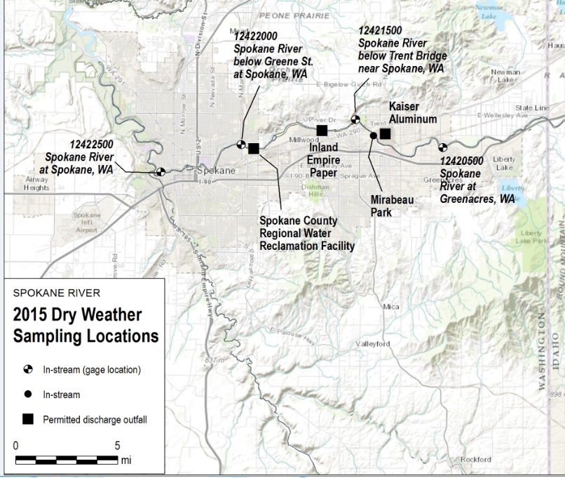
Spatial Temporal Extent
Spatial extent is Greenacres to Spokane Gage
Mirabeau Park station added
Temporal extent of five days
Sample river every day
Sample discharges on days 1, 3, and 5

Slide 4
New Rainfall Rules
What constitutes a “wet weather” event?
Old rule: 0.2” of rain at Felts Field
New rule: Average of 0.2” of rain at eight reporting stations throughout Spokane
What do we do if wet weather occurs?
Postpone initiation if rainfall likelihood greater than 50% for the any of the first three days of sampling
If event occurs on days 1-4, delay 2 days then continue
If event occurs after day 4, terminate

Slide 5
Blank Correction
Proposed language
The “3x blank correction procedure” being used in the SRRTTF’s sampling efforts is just a “placeholder” or “method used at this time” but calculated values may be adjusted in the future using other blank correction methods deemed appropriate.
SRRTTF approved language
It should be noted that there is no standard blank correction method, and numerous approaches are utilized, both nationally and within the Spokane River Basin. The selection of the most appropriate blank correction methodology must consider factors such as: study objectives, sample matrix, sampling methodology, expected range of results, and tolerance for biased results.

Slide 6
Flow Monitoring
Standard procedures for flow monitoring added
Manual flow measurements at multiple stations

