Slide 1
SRRTTF Interpretation of Low Level PCB Data
Project Objectives and Impact on +Blank Correction Procedures

Slide 2
Quality Assurance Project Plans
Data sets can be evaluated and interpreted many different ways
The QAPP defines how data will be used and interpreted.
  Project Objectives describe the question(s) to be studied.
  Quality Objectives describe how the data will answer the question.
    Accuracy (bias) (is it the right value?)
    Precision (what is the certainty around the data point?)
    Representativeness (is the sample representative of the system?)
    Completeness (did we get all the data we expected?)
    Comparability (can we compare our work with other studies?)
  The QAPP sets the standard, but a “perfect study” is rare.
Notes:
Evaluation of Blank Contamination
Trip Blanks
Field Blanks
Laboratory Blanks
October 2013 workshop planning:
How will laboratory blank contamination be evaluated with respect to data acceptance?
When will transfer (trip) blanks and rinsate (equipment) blanks be necessary and how will they be evaluated with respect to data acceptance?

Slide 3
QAPP History 2014
Lab Request for Qualifications & Quotes (RFQQ)
Align with Ecology requirements to the extent possible.
Use labs already approved by Ecology.
Use specifications that identify the laboratory qualifications and can be used to evaluate proficiency.
Use flags and data acceptance criteria that are in line with Ecology.
Permittees would like to review this against the permit QAPPS
QAPP/SAP
Development January –July
Multiple revision for public review
11 signatories (Task Force, agencies, contractors)
March: the 3x blank criteria established.

Slide 4
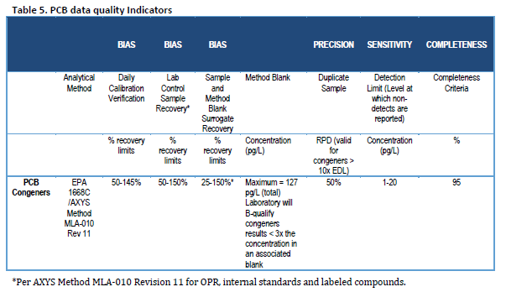
Synoptic Study QAPP and Laboratory Blanks
Accuracy (bias)
Precision
Representativeness
Completeness
Comparability

Slide 5
Blanks
Blanks are “clean” samples used to assess contamination.
  Contamination can impact the ability to achieve quality objectives
Types of blanks
  Equipment and Trip Blanks (used to measure field contamination)
  Method or Laboratory Blanks (used to measure laboratory contamination)
Laboratory blanks are typically charted on statistical control charts
  When a blank exceeds control limits, then the lab investigates and takes corrective action.
  This is a normal aspect of laboratory quality assurance activities.

Slide 6
Method 1668
Method 1668 measures PCBs at very low levels.
  Different congeners can be seen in blanks than samples.
Blank correction, or censoring, is used to address this conundrum.
  Multiple methods exist to do this.
The method used to “blank correct” depends on the study objectives.
“Method 1668 has a detection limit of 2 pg/L. But median levels of PCB in method and rinsate blanks can be has high as 50 pg/L.” (Greg Covallo, DWRBC)

Slide 7
Standard Method of Blank Correction
Results considered to be non-detects (“U”) if the congener concentrations were less than [X] times the concentration in the laboratory method blank:
X = 0: Essentially uncorrected, all values reported.
X = 3 or 5: Used for identifying sources, semi-quantitative analysis.
Some false positives may result.
X = 10: highest level of certainty that the quantified congeners are in the sample. Some congeners may be censored.
LimnoTech evaluated other blank correction procedures.

Slide 8
Uncertainty Due to Blank Correction
Difference in results between alternative blank correction methods

Slide 9
Uncertainty Due to Blank Correction
Comparison between QAPP blank corrected and uncorrected concentrations

Slide 10
Uncertainty Due to Blank Correction
Comparison between subtraction blank corrected and uncorrected concentrations

Slide 11
Considerations for Comparability
Method of analysis and comparability of laboratories
Suite of congeners included in the analysis
Data evaluation against QAPP
  Is the data of adequate quality (meets measurement quality objectives?)
  Suitability of the blank correction procedure (qualitative vs. quantitative)
  Is the data suitable (does it meet the Quality Objectives?)
  Does the data set answer the study objectives?
    Environmental study, clean up, environmental assessment, source identification
Use different blank corrections procedures and evaluate impact on conclusions: uncertainty analysis

Slide 12
Recommendations
Establish protocol for archiving data (raw lab data plus lab blanks)
Identify study objectives in the QAPP
Identify blank correction procedure needed to achieve those objectives
Do an uncertainty analysis to evaluate if the blank correction procedure used makes a difference in the conclusions
Include discussion of blank correction procedure in report
Continue to use the 3x procedure for source identification studies
  Same data may need to be reevaluated if used for another purpose

