Slide 1
Technical Update
Task Force & Technical Track Work Group Meeting
Dave Dilks
June 15, 2016

Slide 2
Items
Revisions to “Magnitude of Source Areas and Pathways” memorandum
Comments on “Inventory of Control Actions” memorandum
Comments on “Cost/Effectiveness of PCB Control Actions” memorandum
2016 Monthly Monitoring Update

Slide 3
Magnitude of Sources and Pathways Last Month’s Comments
Report results as ranges instead of “best estimates”
Include “box and whiskers” plot for WWTP data

Slide 4
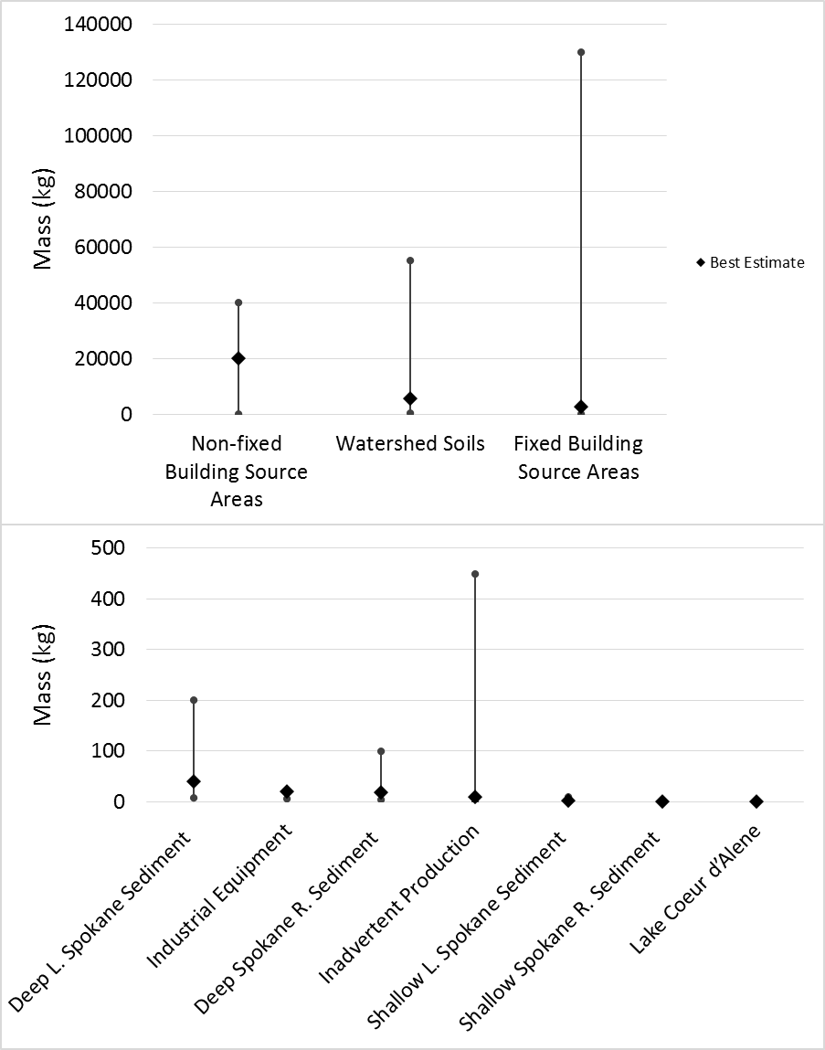
Estimated Range of Mass of PCB in each Source Area Category

Slide 5
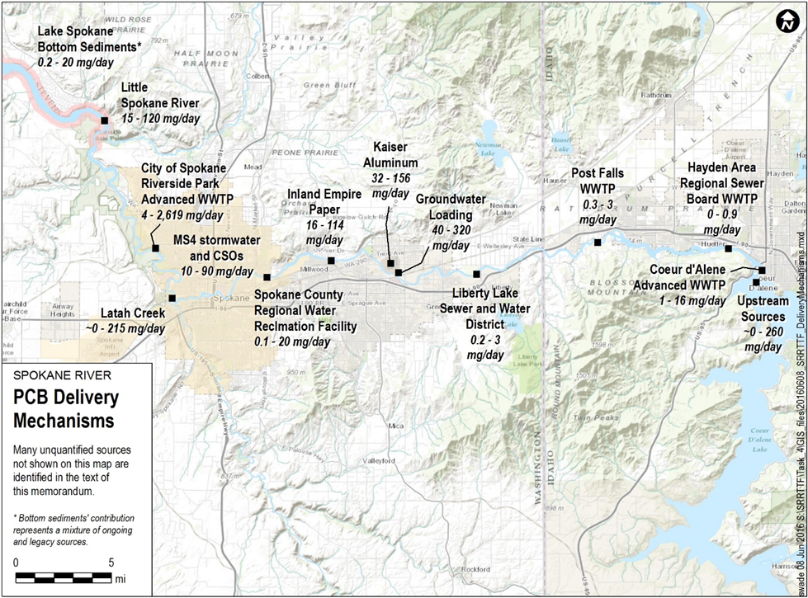
Map of Delivery Pathways, Expressed as Ranges

Slide 6
WWTP Table: Synoptic Surveys
 |  |  | PCB Concentration (pg/l) |  |  |  | PCB Loading Rate (mg/day)
 | No. of Samples | Sample Type | Minimum | Median | Maximum |  | Minimum | Median | Maximum
Industrial
Kaiser | 7 | Grab | 2226 | 3179 | 4625 |  | 69.4 | 98.4 | 156.1
Inland Empire Paper | 7 | Grab | 2629 | 2958 | 4449 |  | 70.7 | 78.6 | 114.4
Municipal
City of Spokane | 4 | Grab | 771 | 1066 | 23404 |  | 82.2 | 112.8 | 2619.0
Spokane County | 7 | Grab | 290 | 330 | 490 |  | 8.2 | 9.4 | 14.1
Coeur d'Alene | 3 | Grab | 531 | 534 | 1227 |  | 7.0 | 7.0 | 16.0
Post Falls | 3 | Grab | 200 | 219 | 221 |  | 1.9 | 2.0 | 2.1
Liberty lake | 3 | Grab | 193 | 200 | 260 |  | 0.5 | 0.5 | 0.7
HARSB | 0 | - | - | - | - |  | - | - | -
Total |  |  |  |  |  |  | 240.0 | 308.7 | 2922.5

Slide 7
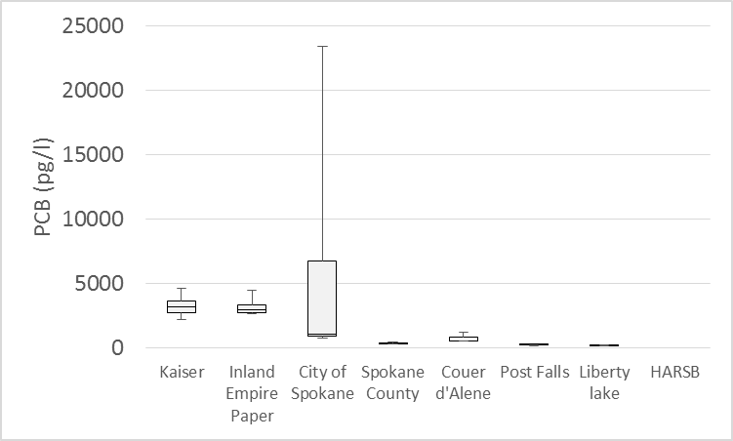
WWTP Graph: Synoptic Surveys

Slide 8
WWTP Table: Routine Monitoring Effluent Concentration (pg/l)
 |  |  | 3x Blank Correction |  |  |  | 10x Blank Correction
 | No. of Samples | Sample Type | Minimum | Median | Maximum |  | Minimum | Median | Maximum
Industrial
Kaiser | 52 | Composite | 1205 | 1982 | 4405 |  | 973 | 1757 | 4291
Inland Empire Paper | 5 | Composite | 1212 | 2978 | 3159 |  | 610 | 2024 | 3065
Municipal
City of Spokane | 22 | Composite | 93.5 | 609 | 1680 |  | 40.7 | 469 | 1654
Spokane County | 13 | Composite | 4.31 | 109 | 792 |  | 4.31 | 31.2 | 226
Coeur d'Alene | 1 | Composite | 435 | 435 | 435 |  | 105 | 105 | 105
Post Falls | 4 | Composite | 101 | 111 | 315 |  | 26 | 39 | 65
Liberty lake | 17 | Composite | 66 | 220 | 1085 |  | 66 | 188 | 971
HARSB | 4 | Composite | 58.7 | 152 | 212 |  | 37 | 96.6 | 201

Slide 9
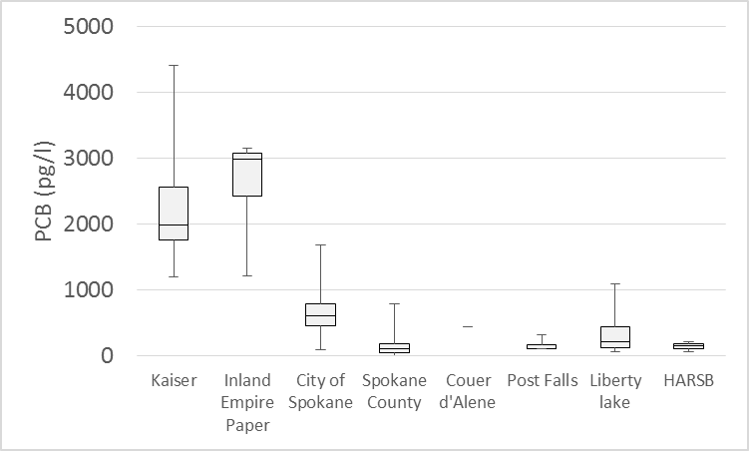
WWTP Graph: Routine Monitoring Effluent Concentration: 3X Blank Correction

Slide 10
WWTP Table: Routine Monitoring Effluent Load (mg/day)
 |  |  | 3x Blank Correction |  |  |  | 10x Blank Correction
 | No. of Samples | Sample Type | Minimum | Median | Maximum |  | Minimum | Median | Maximum
Industrial
Kaiser | 52 | Composite | 39 | 65 | 144 |  | 32 | 57 | 140
Inland Empire Paper | 5 | Composite | 32 | 72 | 82 |  | 16 | 52 | 70
Municipal
City of Spokane | 22 | Composite | 10.4 | 64.6 | 211.8 |  | 3.9 | 48.4 | 208.5
Spokane County | 13 | Composite | 0.12 | 2.85 | 20.1 |  | 0.12 | 0.8 | 6.1
Coeur d'Alene | 1 | Composite | 5.6 | 5.6 | 5.6 |  | 1.3 | 1.3 | 1.3
Post Falls | 4 | Composite | 0.98 | 1.04 | 2.97 |  | 0.25 | 0.37 | 0.61
Liberty lake | 17 | Composite | 0.20 | 0.61 | 2.76 |  | 0.20 | 0.52 | 2.47
HARSB | 4 | Composite | 0.24 | 0.63 | 0.9 |  | 0.15 | 0.4 | 0.86
Total |  |  | 88.5 | 212.3 | 470.1 |  | 54.0 | 160.8 | 429.9

Slide 11
Task 2a: Inventory of Control Actions
New comments received this week
Recommend deferral of approval until comments are incorporated and distributed

Slide 12
Task 2b: Cost/Effectiveness of Control Actions
Initial sets of comments received
  Doesn’t accomplish the goal of “assess the cost reduction efficiency of control actions”
    “Costs” table needs more detail to provide context
    More detail needed on relative magnitude of intermediate pathways, and the ability of a control action to affect delivery
    Confusing presentation
  Idealized case does not seem to add relevant information

Slide 13
Task 2b: Cost/Effectiveness of Control Actions
Proposed revisions
  More detail on what reported costs represent
  Qualitative summary of expected effectiveness of each control action
    Effectiveness of action in controlling its targeted source area or pathway
    Expected reduction in load delivered to river, considering intermediate transport pathways
Revised draft to be prepared by June 22
  Summary presentation at Task Force meeting

Slide 14
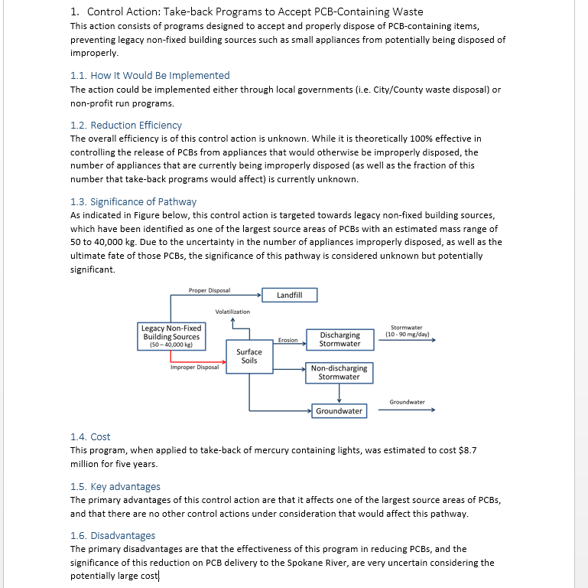
Potential Fact Sheet
Format

Slide 15
Potential Summary Format

Slide 16
Task 2b: Cost/Effectiveness of Control Actions
Official Schedule
  Final draft due July 14
Proposed Interim Schedule
  Revised draft provided by June 22
  Official review draft by July 6

Slide 17
Monthly Sampling Update
March through May sampling completed
Upriver Dam Spillway Rehabilitation
  Starting June 22, reservoir behind the dam will be lowered by two feet
    June sampling moved to this week
  Work scheduled to extend for six months
    Ramifications to fall monitoring will be considered
First round of PCB results received
  Data currently being blank-corrected

