Slide 1
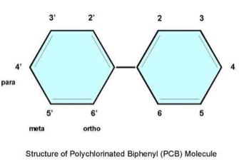
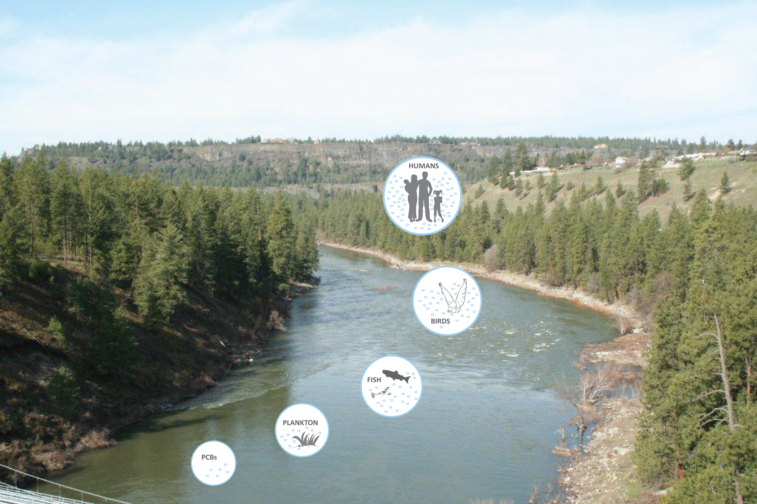
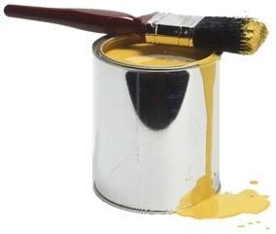
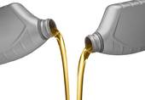
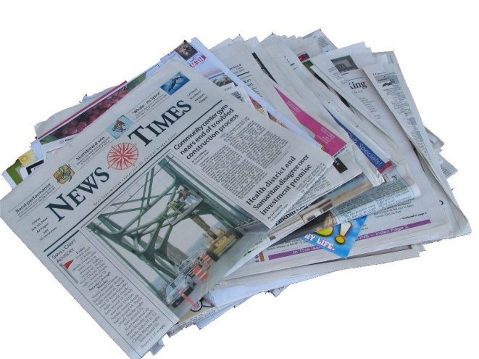
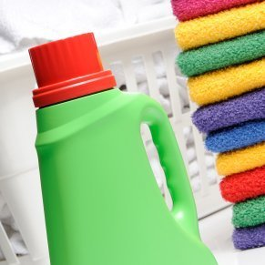
The Challenge of PCBs in the Spokane River
What are PCBs?
Polychlorinated biphenyls (PCBs) are a family of toxic human-made compounds that persist in the environment and accumulate in animal tissue. There are 209 different PCB molecules that range in toxicity. PCB mixtures vary, from thin and light-colored liquids to yellow or even black waxy solids.
Background on PCBs
PCBs were first produced in 1927 and became commercially manufactured in 1935 for their insulating and fire resistant properties. They were used in many products including: oil-based paints, hydraulic fluids, electrical equipment (transformers, capacitors, light ballasts, switches, and electromagnets) as well as adhesives and tapes, cable insulation, building caulking , and floor finish.
When it was found that PCBs build up in the environment and result in serious health effects in animals and humans:
Commercial production of PCBs was curtailed in 1977.
The uncontained use of PCBs was banned in the United States in 1979 via the Toxics Substances Control Act (TSCA).
There were no regulatory controls on PCB disposal before 1979 therefore legacy PCBs can still be found throughout the environment.
In 1979, the estimated global inventory of PCBs was 1.5 million tons.
PCB Regulatory Paradox
PCBs are not only a legacy pollutant. US EPA regulations, under the Toxics Substances Control Act (TSCA), still allow for the production of “inadvertent” PCBs at concentrations up to 50 parts per million (ppm). This Federal allowance is many orders of magnitude above all water quality standards for PCBs. Recent testing by the Department of Ecology found that PCBs are present in commonly used consumer products. Forty-nine of 68 products tested contained PCBs (Dept. of Ecology, 2014).
Health Effects of PCBs
PCBs end up in our environment, including our lakes and rivers. Here they persist and travel up through the food chain, in some cases having ongoing impacts to humans and the environment. PCBs concentrate in fish tissue if they are living in PCB contaminated water, even at low levels. This is a serious issue, particularly for people that consume fish from the Spokane River. Exposure to PCBs can result in skin ailments and liver damage, and they are a probable carcinogen. PCBs also have negative health effects on immune, reproductive, nervous, and endocrine systems.
What can you do about PCBs?
Manage PCBs better and prevent them from entering the environment. This will take a comprehensive approach that addresses many sources including consumer products.
Properly store and dispose of your household waste.
Cover waste to prevent contact with storm water.
Fix vehicle fluid leaks.
Do not dump anything into a storm drain.
How do PCBs enter the Spokane River?
PCBs are not manufactured in Spokane. There are many sources of PCBs to wastewater treatment plants. These include stormwater, human waste, industrial processes, consumer products, clothing dyes, and the inks in recycled newsprint. The wastewater treatment plants are effective in removing significant amounts PCBs from water but are unable to get down to the low levels of the water quality standards. While work is underway to reduce PCBs in contaminated soils, from stormwater systems, and in waste treatment plants, there are still unknown sources that need to be identified and addressed. Once sources are more clearly understood, identification of the best way to reduce the sources of PCB to the river can begin. PCBs enter the river:
It is difficult to precisely calculate PCB source contributions due to low PCB concentrations and natural variability.
Potential sources of PCBs in the Spokane River Watershed
Motor oil (up to 2 ppm allowed by EPA)
Detergent bars (up to 5 ppm allowed by EPA)
Fish and animal feed (up to 2 ppm allowed by FDA)
Food wrappers (up to 10 ppm allowed by FDA)
Human food (0.2 to 3 ppm in milk, eggs, other dairy products, poultry, fish, shellfish, and infant foods allowed by FDA)
PCB Cleanup and Source Reduction
In the past 20 years there has been a significant decrease of PCBs in the Spokane River because of cleanup and regulatory actions.
Remediation has directly removed significant sources of PCBs.
Natural reductions in PCBs have also occurred due to EPA bans on commercial production and restrictions on use.
More work is needed, however, if we are to have a clean river. In order to achieve the water quality goals for the river we need to significantly reduce levels of PCBs. This will take a coordinated approach where everyone works together – locally, across the state, and at the national level – to achieve this goal.
PCB Regulatory Relationships (ppm) Magnitude Difference Relative to the Federal TSCA Allowance
Reference | PCB Concentration (ppm) | Magnitude Difference
Federal TSCA Allowance | 50 | ---
EPA & WA Current HHWQC* | 0.000000007 | 294,117,647
Spokane Tribe WQS** | 0.0000000013 | 38,461,538,462
*HHWQC - Human Health Water Quality Criteria. Preliminary Draft Rule (9/30/2014) (Source: 40 CFR 131.36) ** Spokane Tribe Water Quality Standard: Adopted a Fish Consumption Rate of 865 grams/day (1.9 pounds per day)
Through storm water run-off
Through the atmosphere from the water cycle - rain and snow - atmospheric deposition
Through the home and PCB-containing consumer products
Through wastewater treatment plants:
Human waste flushed down our toilets
Printed clothing and paint products
Pigments in recycled newspaper
Reference: Ecology Spokane River PCB Source Assessment, April 2011
“Be careful what you put down the drain; only rain down the storm drain”.

