Slide 1

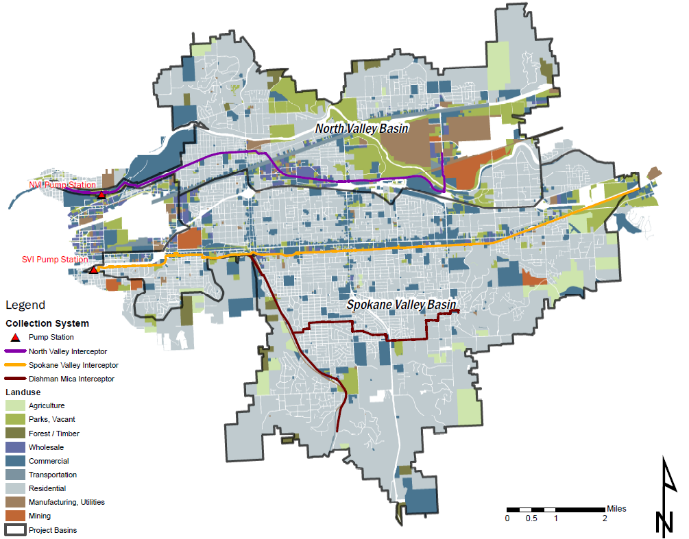
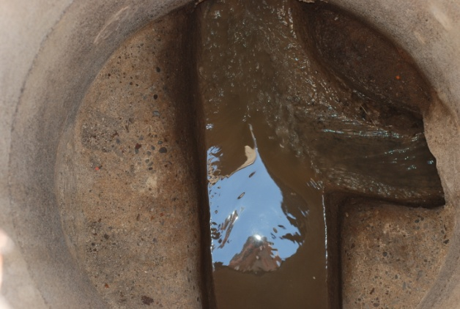
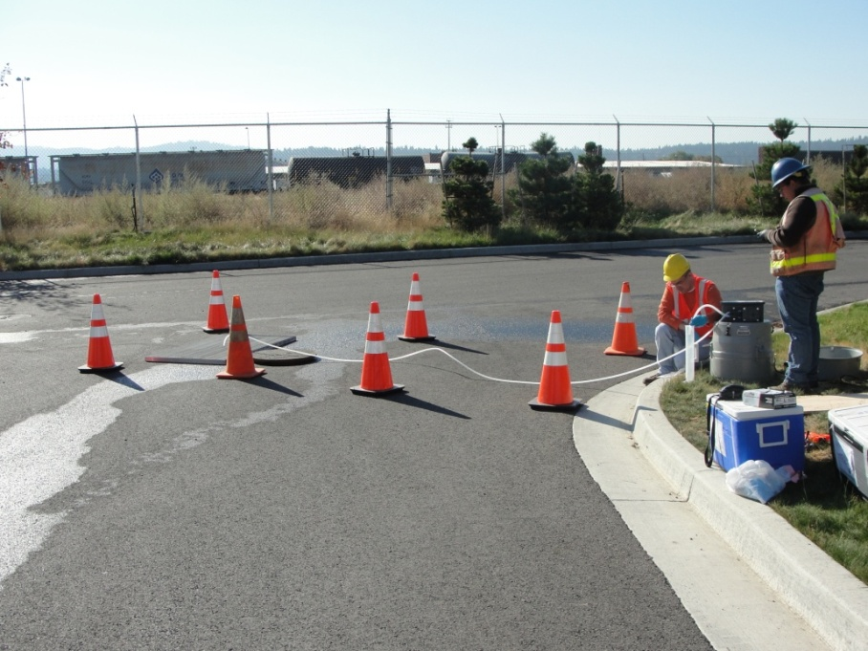
Spokane County Wastewater Toxics Monitoring – Year One
April 24, 2013 | DRAFT

Slide 2
Agenda
NPDES permit requirements
Sampling locations & methods
Results
Next steps (draft)
  Draft Action submitted to Ecology on 4/15/2013
Notes:
BC is working with GeoEngineers and Axys Analytical

Slide 3
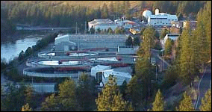
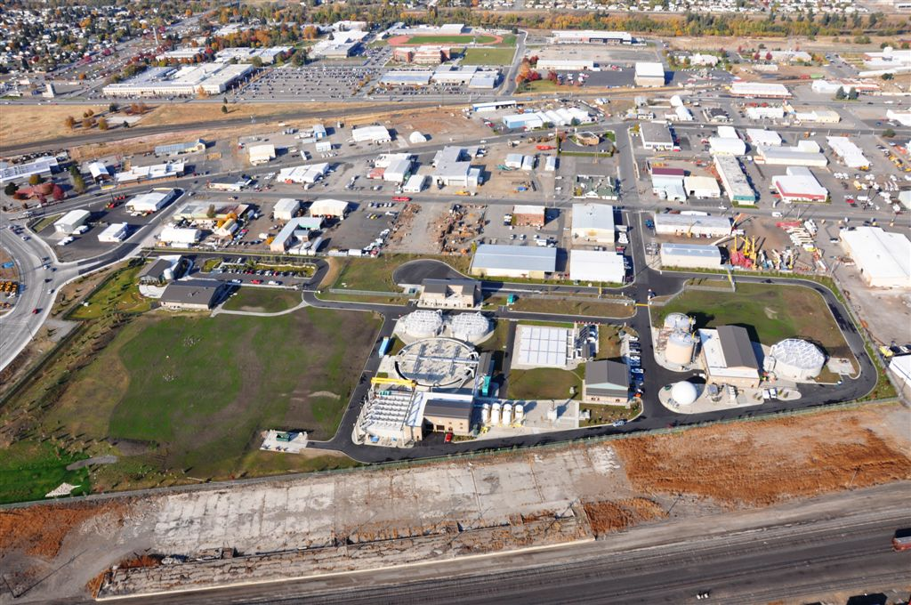
Spokane Area – Sewer Service
City of Spokane Riverside Park Water Reclamation Facility
▲
N
North Spokane
... serves North Spokane
Spokane Valley
Spokane County Regional
Water Reclamation Facility
Downtown
Spokane
... serves Spokane Valley
Notes:
First click explanation (the initial view): Here is a map depicting regional sewer service areas for the City of Spokane (lighter tan) and Spokane County (darker tan). The City generally serves customers within city limits and a few outside of city limits. The County generally serves customers in North Spokane and the Spokane valley to the east.
Second click explanation: Currently, all sewage is treated at one location --- the Riverside Park Water Reclamation Facility (near the Downriver Golf Course).
Third click explanation: 12 years ago, in 1999, the City and the County agreed that future needs for additional levels of treatment at RPWRF, combined with the limited available space at that site, plus added flows from eliminating septic systems, would require more regional treatment capacity at a new location.
Fourth click explanation: The ensuing years of planning by the City and County resulted in an agreement for the County to construct a new facility to handle the projected treatment needs for the Spokane valley area.
Fifth click explanation: Given the need to serve the valley, related planning ultimately selected the former Stockyards site as the preferred location. So here we are today, nearly completed with 12 years of planning, permitting, design and construction of that new facility (SCRWRF).

Slide 4
NPDES Permit Special Conditions
S2 requires monitoring of Spokane County Regional Water Reclamation Facility (SCRWRF) influent and effluent
Wastewater Influent Sampling
Constituent | EPA Method | Location Description | Minimum Sampling Frequency | Sample Type
Total PCBs | 1668 | Each influent trunk line | Bimonthly (6/year) | 24-hour time-weighted composite
2,3,7,8-TCDD | 1613 | Each influent trunk line | Bimonthly (6/year) | 24-hour time-weighted composite
PBDE | 1614 | Each influent trunk line | 1 per quarter | 24-hour time-weighted composite
Wastewater Effluent Sampling
Constituent | EPA Method | Location Description | Minimum Sampling Frequency | Sample Type
Total PCBs | 1668 | After last treatment process | 1 per quarter | 24-hour time-weighted composite
2,3,7,8-TCDD | 1613 | After last treatment process | 1 per quarter | 24-hour time-weighted composite
PBDE | 1614 | After last treatment process | 1 per quarter | 24-hour time-weighted composite

Slide 5
NPDES Special Permit Conditions (cont’d)
S9 requires preparation of a Quality Assurance Project Plan (QAPP)
S12 requires development of a plan with a goal of reducing to the maximum extent practicable PCB loads in the County’s wastewater collection system
  Influent sample results are needed to help identify PCB sources
Notes:
We prepared QAPP and SOP last summer. Ecology approvied QAPP on 10/1/13

Slide 6
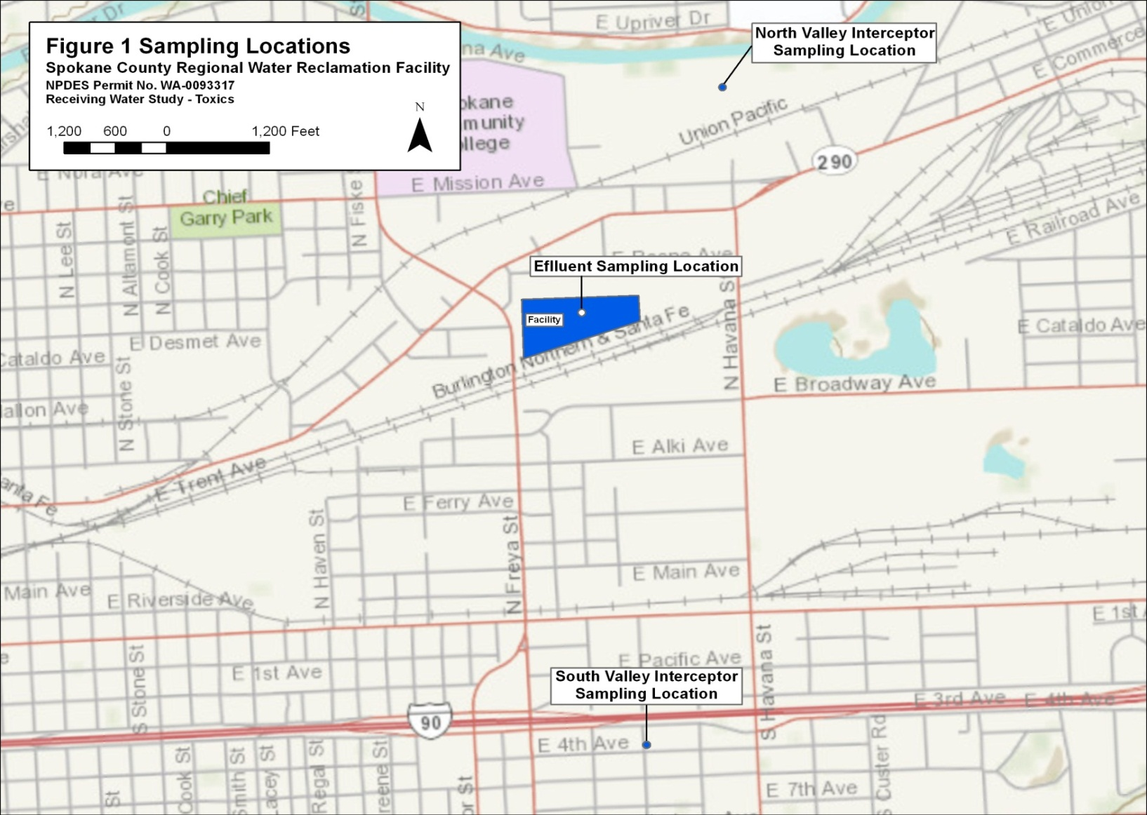
Sampling Locations – Year One
North Valley Interceptor
Sampling Location
Effluent Sampling Location
Spokane Valley Interceptor
Sampling Location
Notes:
Ecology approved our QAPP on 10/1/12. We started sampling the following weeks

Slide 7
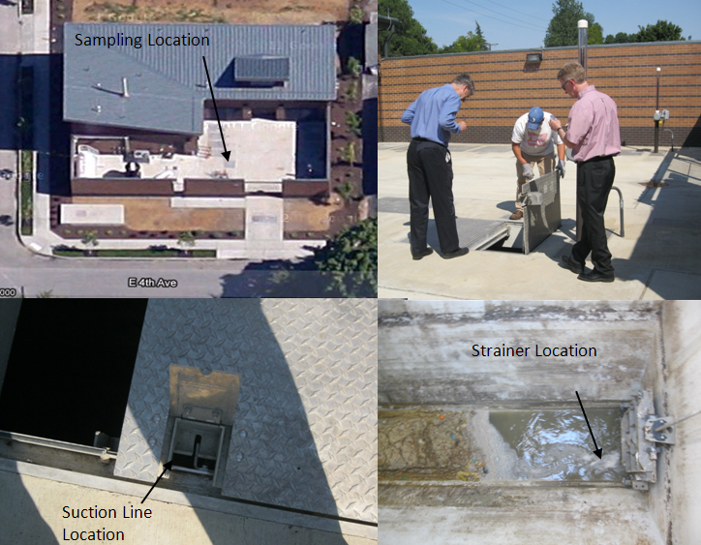
Sampling Location – Spokane Valley Interceptor (SVI) Pump Station

Slide 8
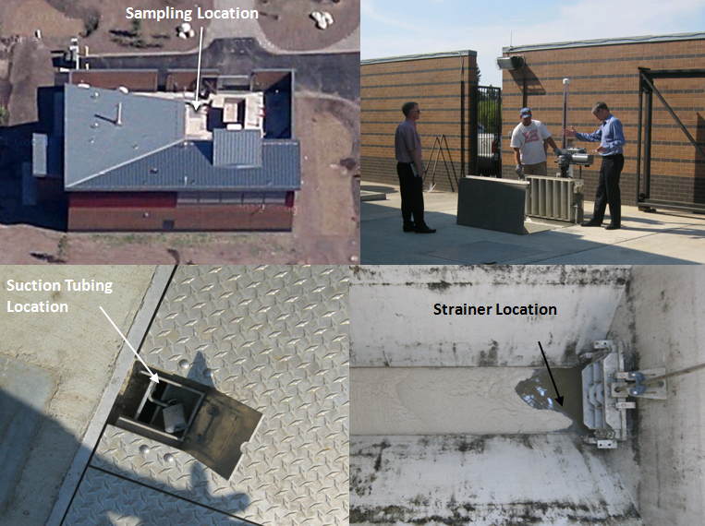
Sampling Location – North Valley Interceptor (NVI) Pump Station

Slide 9
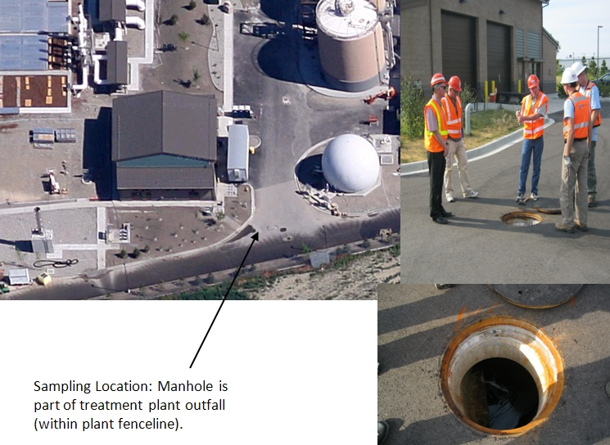
Sampling Location – SCRWRF Effluent

Slide 10
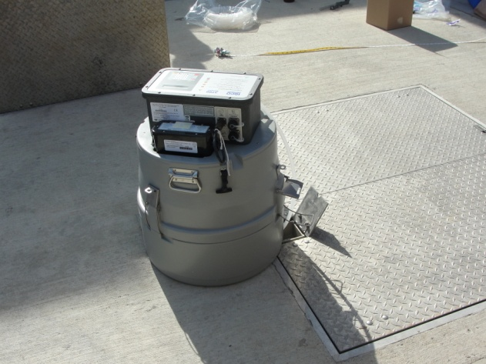
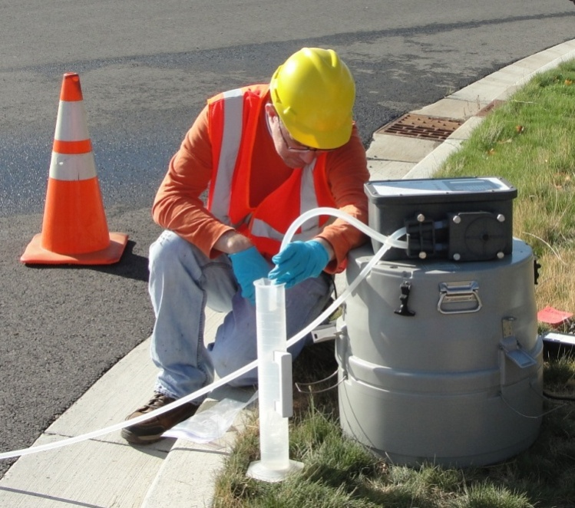
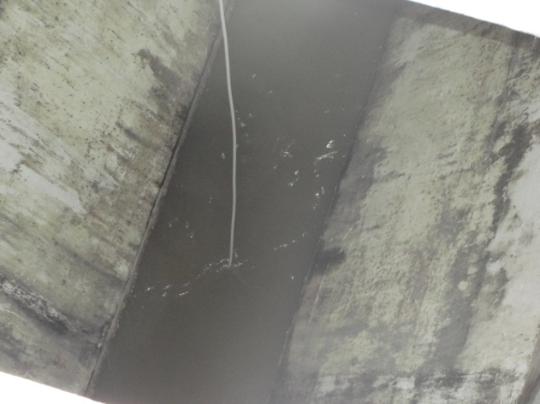
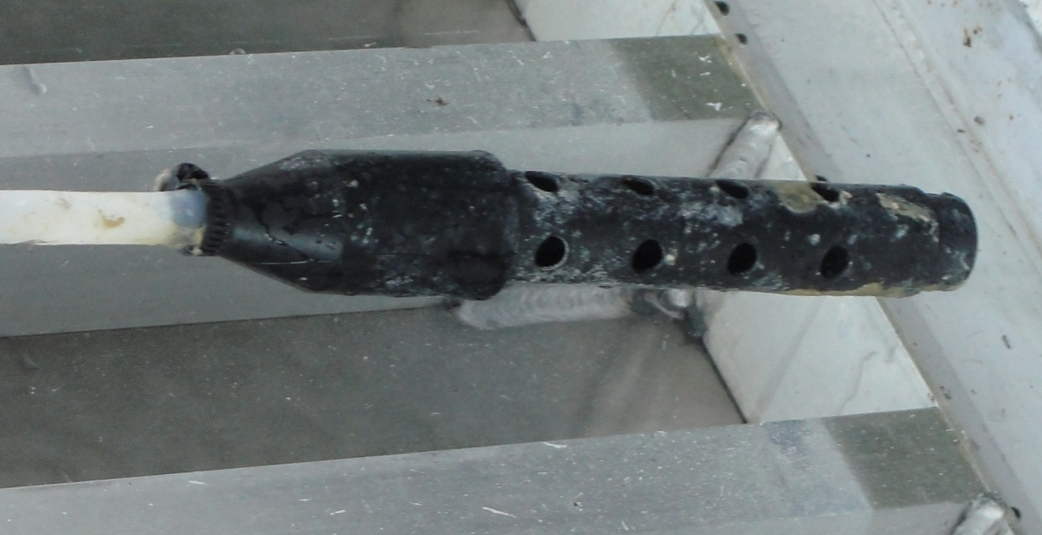
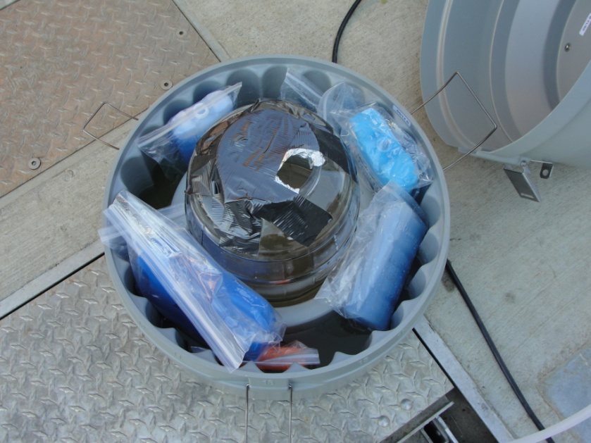
Sampling Procedures
Automated Sampler
Sampler Calibration
Teflon Tubing
Sampler Intake
Composite Sample Bottle

Slide 11
2,3,7,8-TCDD Results
Table 2-4. Laboratory Results for 2, 3, 7, 8-TCDD for First Three Events (pg/L)
Location | 2,3,7,8-TCDD concentration (pg/L)
 | Event 1 | Event 2 | Event 3
NVI | < 0.522 U | < 0.515 U | < 0.519 U
SVI | < 0.516 U | < 0.519 U | < 0.503 U
SVI duplicate | NT | < 0.827 KJ | NT
Effluent | < 0.517 U | NT | < 0.543 U
Effluent duplicate | NT | NT | < 0.517 U
NVI rinsate | < 0.503 U | NT | < 0.515 U
SVI rinsate | < 0.507 U | NT | NT
Effluent rinsate | < 0.504 U | NT | NT
Travel blank | < 0.581 U | < 0.534 U | < 0.549 U
Lab blank | < 0.500 U | < 0.500 U | < 0.500 U
NT = not tested
U flags indicate the substance was not detected at the reporting level.
K flags indicate a peak was detected but did no meet qualification criteria. The result reported is the estimated maximum possible concentration
J flags indicate that the sample concentration was lower than the lowest calibration equivalent
Notes:
None of the samples contained 2,3,7,8-TCDD at levels above the laboratory quantitation criteria. Table 2‑4 presents the flagged 2,3,7,8-TCDD results as reported by the laboratory.

Slide 12
PBDE Results
Total PBDE Concentrations (pg/L) for Events 1 and 3
 | NVI | NVI Duplicate | SVI | SVI Duplicate | Effluent | NVI rinsate | SVI rinsate | Effluent rinsate | Travel blank | Lab blank
Event 1 | 133,581 | NT | 321,819 | 338,298 | 1,374 | 119 | 289 | 100 | 75 | 98
Event 3 | 50,721 | 55,928 | 210,199 | NT | 789 | 657 | NT | NT | NT | 3,411
NT: Not tested
Notes:
Note that effluent, etc. Were too low to show up on the chart

Slide 13
PBDE Results
Influent
Notes:
Note that effluent, etc. Were too low to show up on the chart

Slide 14
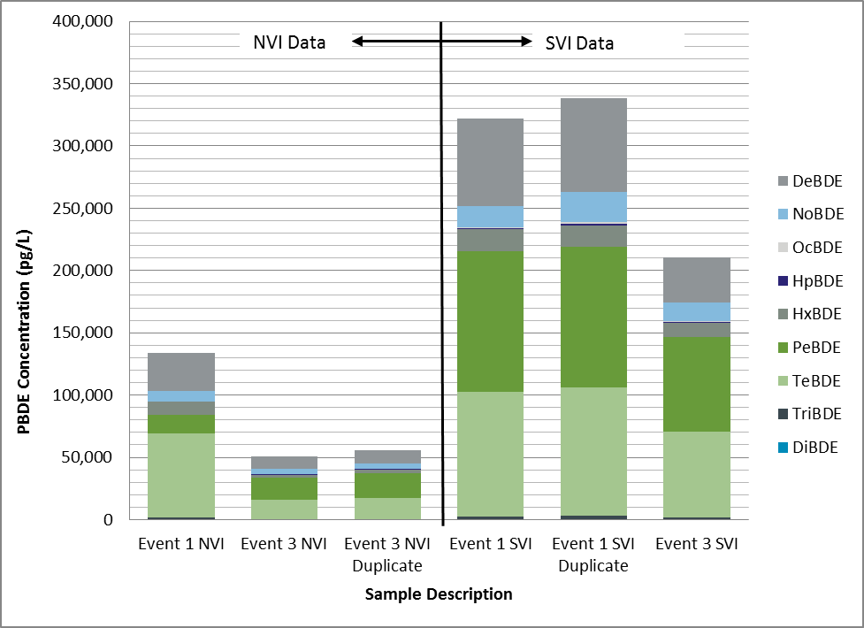
PBDE Homologs – Influent Samples
Notes:
The limited data suggest that SVI appeared to have higher concentrations of tetra-, penta-, and deca-brominated diphenyl ethers than the NVI samples. Also, the Event 3 PBDE concentrations at the NVI appeared to be lower than those observed during Event 1. However, there are not enough data to support statistical analyses. More detailed pattern analysis will be conducted for the next annual report when additional data are available.

Slide 15
PCB Results
Total PCB Concentrations (pg/L) for First Three Events
 | NVI | NVI Duplicate | SVI | Effluent | NVI rinsate | SVI rinsate | Effluent rinsate | Travel blank | Lab blank
Event 1 | 11,515 | 10,998 | 10,563 | 243 | 314 | 229 | 178 | 202 | 614
Event 2 | 12,455 | NT | 9,384 | NT | NT | 463 | NT | 97 | 58
Event 3 | 8,415 | NT | 10,328 | 248 | 75 | NT | NT | 83 | 72
NT: Not tested

Slide 16
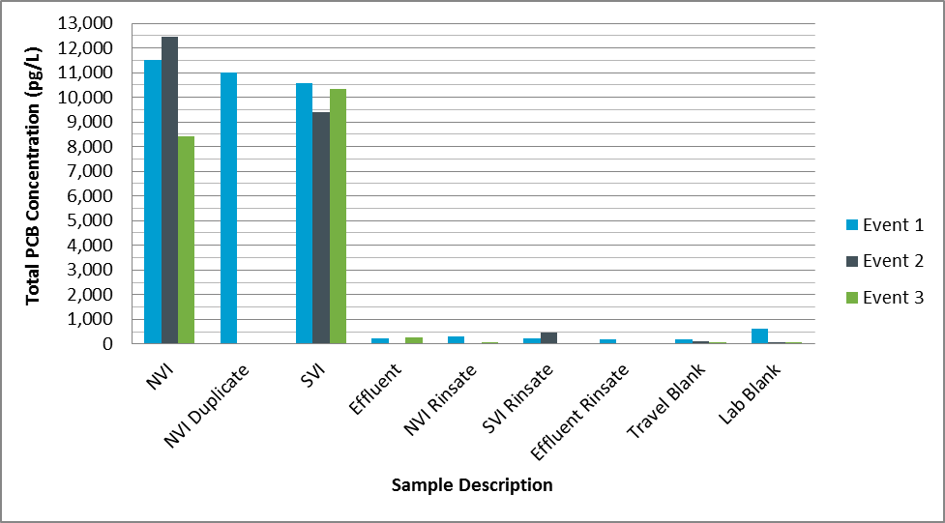
PCB Results
Influent

Slide 17
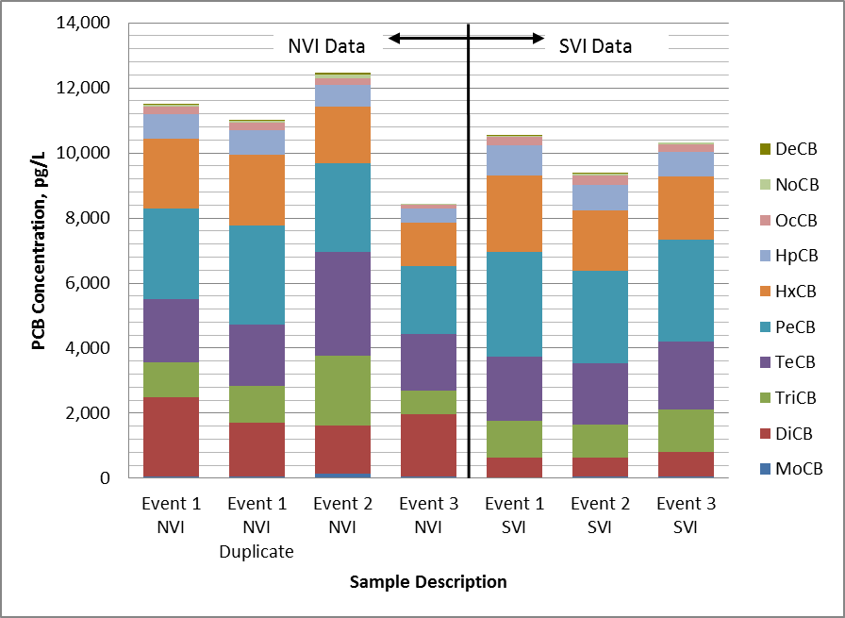
PCB Homologs - Influent Samples
Notes:
PCBs may be grouped in terms of homologs. Homolog groups are based on the number of chlorine molecules attached to the biphenyl ring. Congeners with a single chlorine molecule are grouped into the Monochlorobiphenyl homolog group (MoCB), congeners with two chlorine molecules are grouped into the Dichlorobiphenyl homolog group (DiCB), and so on. Tables 2-6, 2-7, and 2-8 present the total PCB concentration for each homolog group for Events 1, 2, and 3, respectively. Data from the two influent sampling locations are summarized graphically on Figure 2-4.
The limited data suggest that NVI appeared to have slightly higher concentrations of dichloro biphenyls than the SVI samples, while the SVI samples appeared to have slightly higher concentrations of pentachloro biphenyls than the NVI samples in Event 3, but similar concentrations in Events 1 and 2. There are not enough data to support statistical analyses; however, more detailed pattern analysis will be conducted for the next annual report when additional data are available.

Slide 18
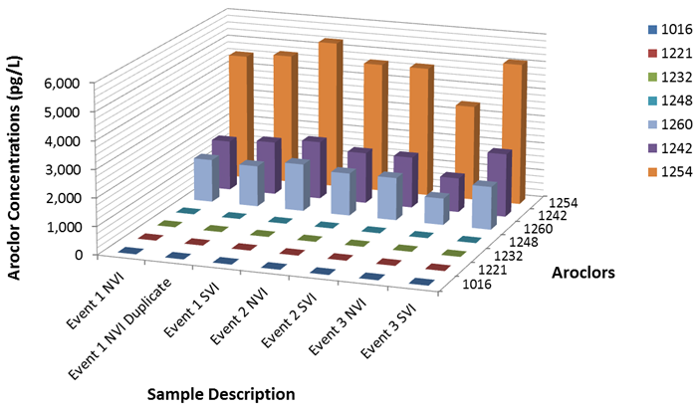
PCB Aroclor Results – Influent Samples
Notes:
. The three Aroclors found in the NVI and SVI samples could have originated from a wide range of sources such as electrical transformers, capacitors, hydraulic fluids, rubber products, varnishes, and a variety of other products. Some of these products can be found in commercial or residential areas as well as industrial areas

Slide 19
Common Uses of Aroclors
Table 2-11. Common Uses of Aroclors
Common uses | Aroclor
 | 1016 | 1221 | 1232 | 1242 | 1248 | 1254 | 1260
Adhesives |  |  | ✓
Capacitors | ✓ | ✓ |  |  |  | ✓
Carbonless copy paper |  |  |  | ✓
Chlorinated rubber |  |  |  |  |  | ✓
Crepe rubber
Cutting oils |  |  |  |  |  | ✓
Dedusting agents |  |  |  |  |  | ✓ | ✓
Epoxy resins |  | ✓ |  |  | ✓
Ethylene vinyl acetate |  |  |  |  |  | ✓
Gas transmission turbines |  | ✓ |  | ✓
Heat transfer |  |  |  | ✓
Hydraulic fluid |  |  | ✓ | ✓ | ✓ | ✓ | ✓
Inks |  |  |  |  |  | ✓
Neoprene
Nitrocellulose lacquers
Pesticide extenders |  |  |  |  |  | ✓
Polyester resin |  |  |  |  |  |  | ✓
Polystyrene |  | ✓
Polyvinyl acetate |  | ✓ | ✓ | ✓
Polyvinyl chloride |  |  |  |  | ✓ | ✓ | ✓
Rubber |  | ✓ | ✓ | ✓ | ✓
Sealants and caulking compounds |  |  |  |  |  | ✓
Styrene-butadiene co-polymers |  |  |  |  |  | ✓
Synthetic resins |  |  |  |  |  | ✓
Transformers |  |  |  | ✓ |  | ✓ | ✓
Vacuum pumps |  |  |  |  | ✓ | ✓
Varnish |  |  |  |  |  |  | ✓
Wax
Wax extenders |  |  |  | ✓
Sources: Nagpal (1992), ATSDR (2000)

Slide 20
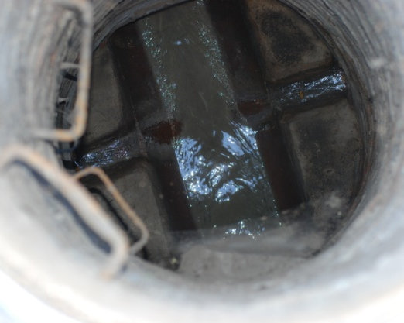
Next Steps (Draft)
Work with Ecology to update the QAPP
Begin trackdown sampling in collection system upstream of NVI and SVI pump stations
Wastewater in County collection system

Slide 21
Potential Trackdown Strategies (Draft)
“Top-down” strategy - focus on known or suspected sources
“Bottom-up” strategy- systematic downstream to upstream approach
Notes:
Top –down strategy focuses on suspected hotspots
Bottom-up strategy is systematic approach
Sample results include PCB concentrations, homolog and congener patterns
Sewershed attributes include current or past land uses, spills, etc. that could be sources of the PCBs found in the samples

Slide 22
Land Uses by Basin
Table
3
-
1. Land Use within the Five Basins
D
elineated on Figure
3
-
2
Land
U
se
NVI Upper
SVI Upper
DMI
SVI_Lower
NVI_Lower
Agricultural
3.1%
4.6%
4.4%
0.8%
0.0%
Commercial
9.2%
14.7%
6.7%
13.9%
19.7%
Forest/timber
1.6%
0.0%
1.6%
0.1%
0.0%
Manufacturing
8.5%
0.5%
0.6%
1.2%
1.6%
Mining
2.4%
0.6%
0.0%
3.5%
0.0%
Parks,
v
acant
15.1%
5.7%
1.4%
4.2%
5.3%
Residential
45.4%
60.0%
75.6%
50.1%
50.7%
Right of Way
10.2%
12.9%
9.5%
21.1%
17.0%
Transportation
2.4%
0.0%
0.1%
1.7%
4.6%
Wholesale
2.0%
0.9%
0.1%
3.4%
1.1%
Summary
Residential
45.4%
60.0%
75.6%
50.1%
50.7%
Commercial/industrial/ROW
34.7%
29.7%
17.0%
44.9%
44.0%
Open
spaces
19.8%
10.3%
7.4%
5.0%
5.3%

Slide 23
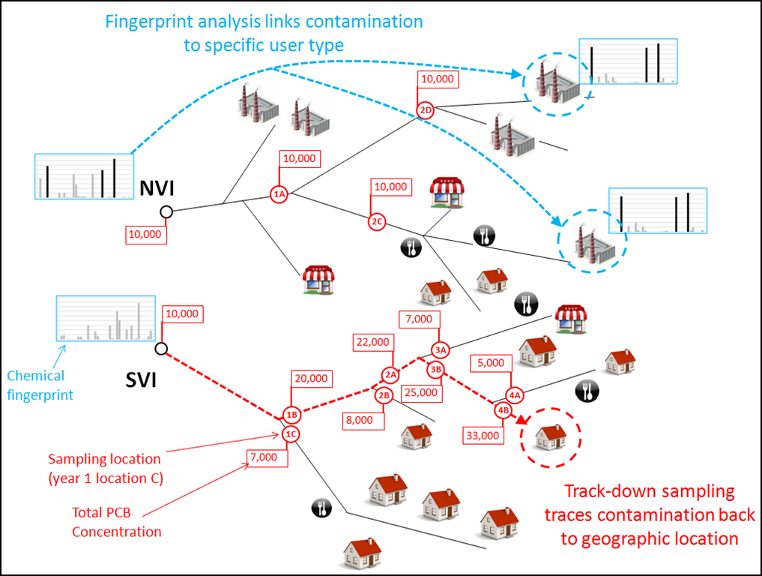
Proposed Trackdown Approach (Draft)

Slide 24
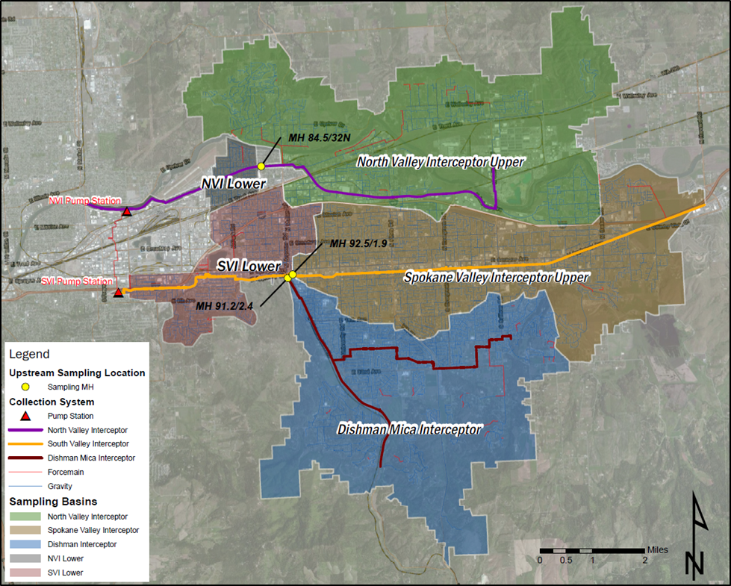
Proposed Trackdown Locations for 2013 (Draft)
Notes:
During 2013, track-down sampling will be conducted at three locations (in addition to the NVI and SVI sampling). The locations were selected to divide the service area into five large tributary basins
A sampling location along the NVI divides the NVI tributary area into two basins—the NVI Upper (upstream) and NVI Lower (downstream) basins. Two sampling locations along the SVI divide the SVI into three tributary basins—the SVI Upper (upstream), the Dishman Mica Interceptor (DMI, also upstream), and the SVI Lower (downstream).

Slide 25

Questions?

Slide 26
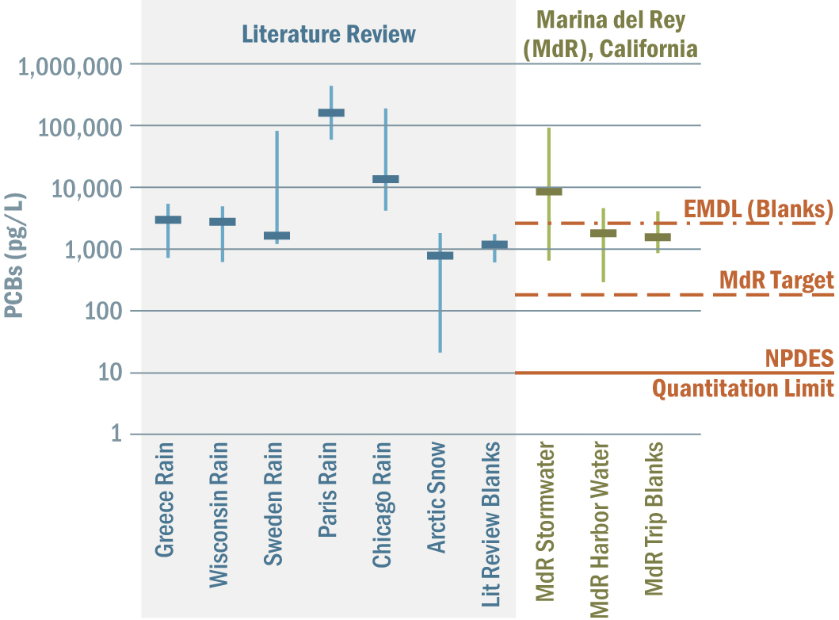
PCB Monitoring Considerations
Notes:
PCBs are a concern at very low levels.
Right side of chart shows our MDR experience. Blank PCBs were higher than Natl. Toxics Rule (170 pg/L)
NPDES target is 10 pg/L per congener
Left side of chart shows PCBs in rain and snow are often much higher than our proposed target (which may help explain why blanks have high PCBs)

Slide 27
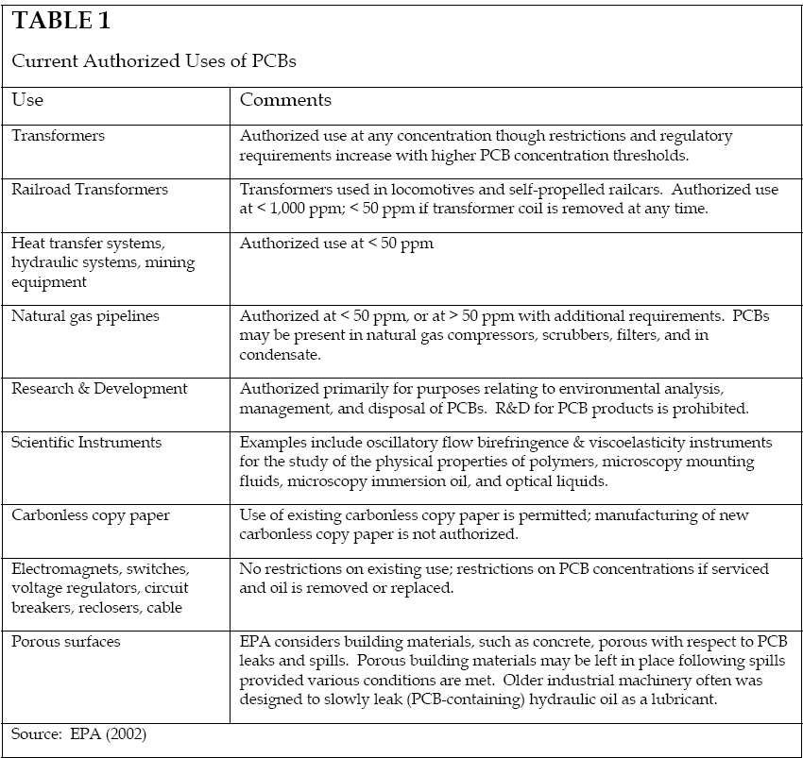
Potential PCB Sources

Slide 28
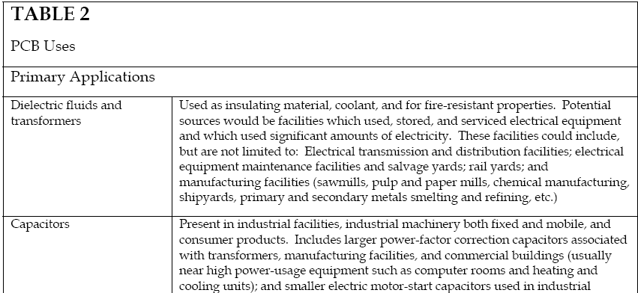
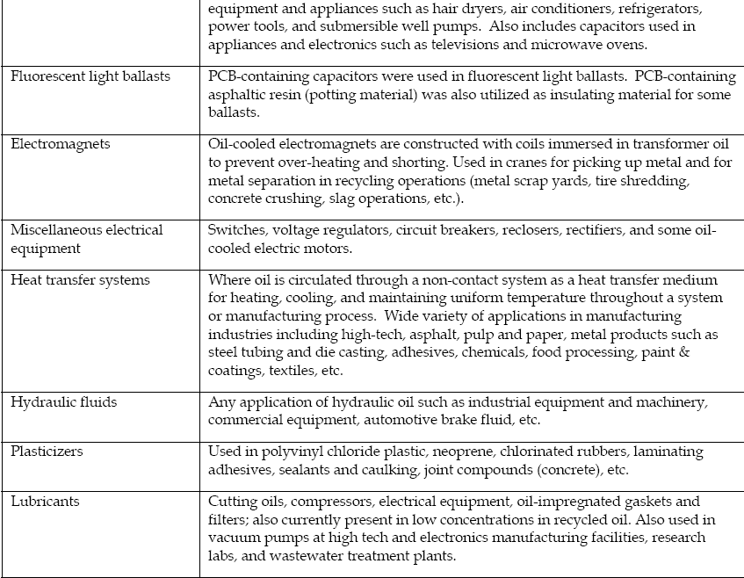
Potential PCB Sources

Slide 29
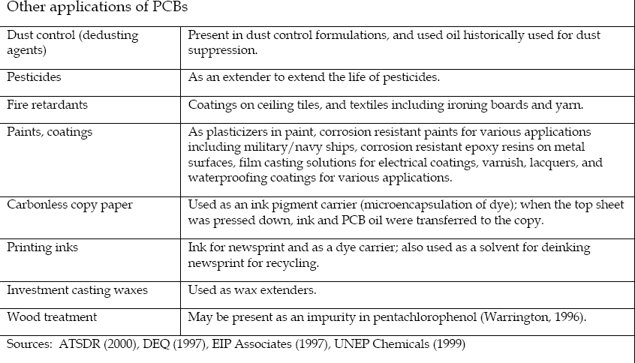
Potential PCB Sources

Slide 30
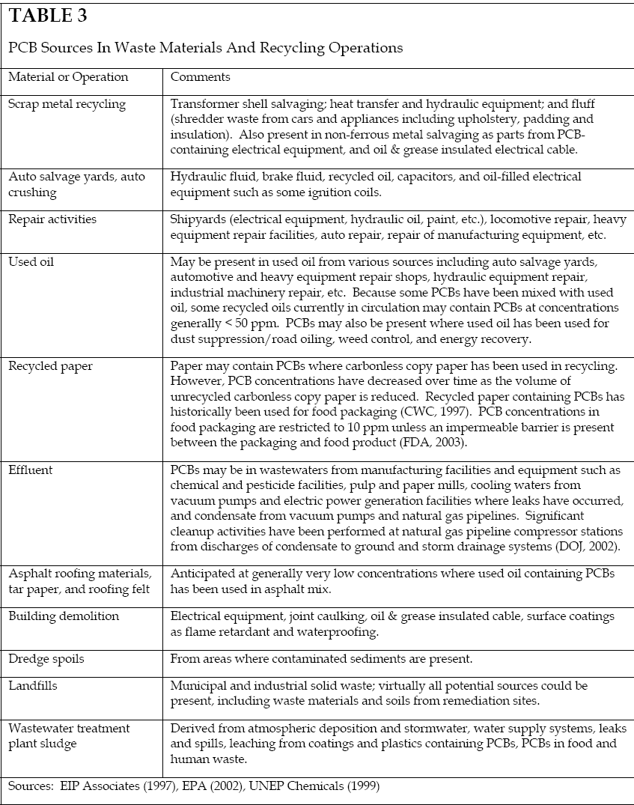
Potential PCB sources

