Slide 1
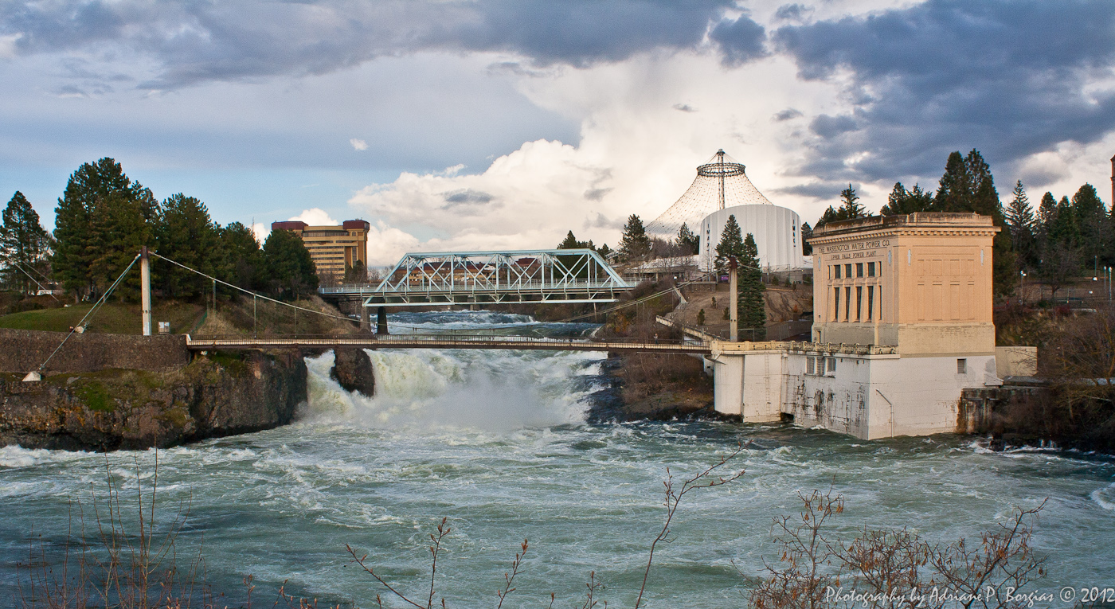
Toxics Management Plans
Ecology Review Principles

Slide 2
Definitions
Environmental Action Plan
A plan that translates policy into action
Environmental Goal or Objective(s)
What the plan is trying to achieve
Environmental Targets
Detailed performance requirements needed to achieve the objective(s)
Tasks
Defined activities that lead to achieving Targets
Continuous Improvement
Enhancements needed to improve performance

Slide 3
Toxics Reduction Management Plans
Environmental Goals
Reduce toxics loadings (including PCB) to the Spokane River
Bring the Spokane River into compliance with the Water Quality Standard

Slide 4
Toxics Reduction Management Plans
Purpose of the review
Ensure plans meet basic permit requirements
Verify data is of acceptable quality
Establish process for plan review and update
Achieve the environmental objectives
Use consistent review framework
“Plan, Do, Check, Act”

Slide 5
Plan Elements
Objectives:
Achieve the Water Quality Standard and
Reduce loadings of toxics to the Spokane River
Targets:
Statistically significant reductions of toxics in influent concentrations over the next 10 years.
Reduce PCBs in the effluent to the maximum extent practicable

Slide 6
Plan
What are the
Identified sources?
Potential sources?
Future source identification activities?

Slide 7
Types of sources
Contaminated soils and sediments
Stormwater
Industrial sources
Commercial sources
Older mechanical equipment
Older electrical equipment
Paints and caulking
Inks and dyes
Soaps and cleaners

Slide 8
Do
For identified sources consider the options:
Don’t make it
Don’t use it
Use less of it
Manage it
Treat it

Slide 9
List and Prioritize Actions
Source reduction tools:
Procurement practices
Public education and ordinances
“PCB-free”
Link actions to objectives and targets
Actions may deal with individual processes, projects, products, services, sites, or facilities
Address schedules, resources, and responsibilities for achieving the objectives and targets

Slide 10
Check
Assure Data Quality: QAPP
Goals
Sampling and chemical analysis methods
Data review and interpretation
Collect Data
Permit requirements (influent, effluent)
Other measurements
Prepare Annual Report
Analytical results with QA/QC data and comments
Identification of sources (existing, new and potential)
Summary of activities and accomplishments

Slide 11
Act
Continuous Improvement
The plan is dynamic and should address changes in processes, projects, products, services, sites, or facilities
Review and Update Plan based on
Data quality, patterns and trends (of homologs)
Effectiveness of sampling schemes and schedules
Identification of sources and data gaps
Ability to demonstrate progress
Effectiveness of the plan and lessons learned
Changes in legislation, expectations, requirements, activities, technology, incidents, market preferences, reporting, and communications
Document Plan Changes

Slide 12
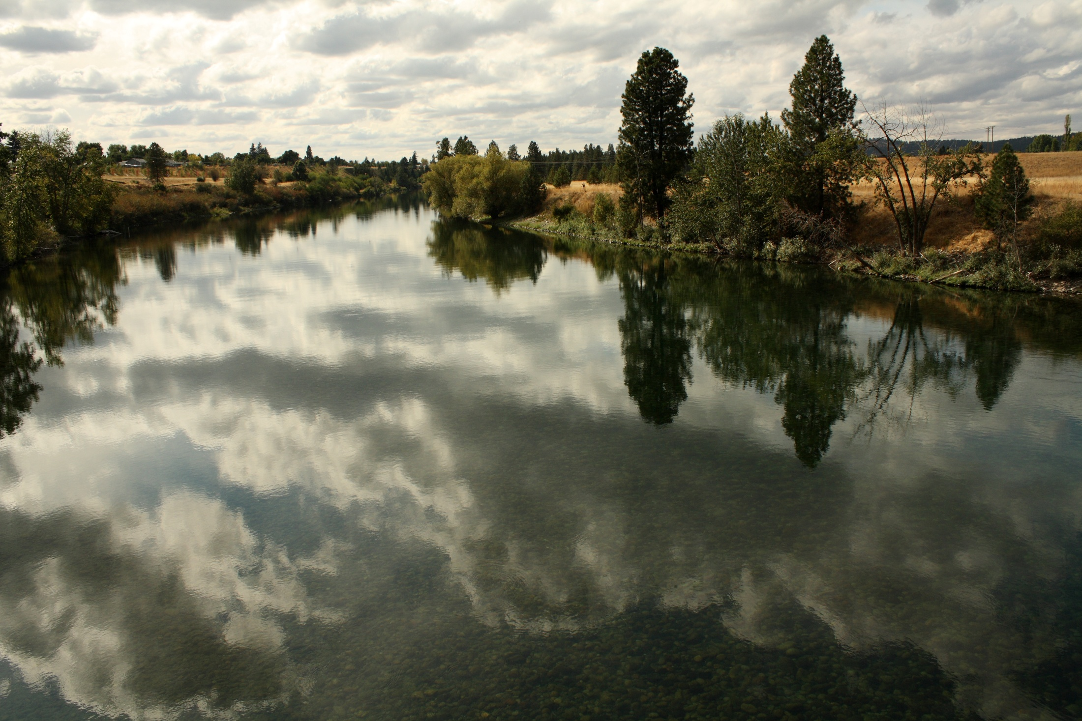
Questions?

Slide 13
For More Information
Spokane River Regional Toxics Task Force
www.srrttf.org
Adriane P. Borgias
Spokane River Water Quality Lead – Toxics
Washington State Department of Ecology
509 329 3515
ABOR461@ecy.wa.gov

